Slide 1
Columbus, West Indies
& the British Disease
Pox and Clap
Gifted to the indigenous people of
The Pacific New Zealand Australia
Notes:
Clap - venereal infection causing burning and discharge is as old as man
Great pox - first reported after Columbus returned to Spain in 1493
Smallpox - the world wide epidemic disaster through the centuries
Until the 19th century gonorrhoea and syphilis were considered to be manifestations of the same disease and also confused with the lepromatous form of leprosy.

Slide 2
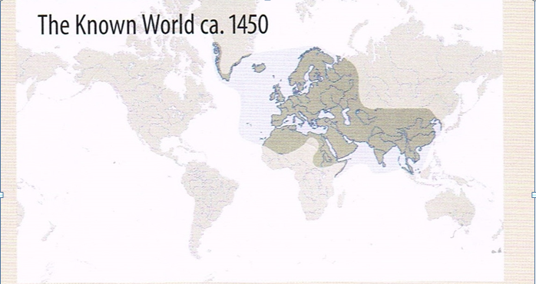
Until the middle ages, the world as it was known to Europeans consisted only of Asia, North Africa and islands closest to Europe
Notes:
Extent of the known world was limited by the concern of sailors when their ship to ventured into the unknown out of sight of land.
Primitive navigators used the stars to reach known objectives but these limited the safe distance.
Vikings reached North America around the North Atlantic.
Inspired by Prince Henry the navigator, the Portuguese reached the Sargasso Sea.
Siberian wilderness and Sahara desert also acted as barriers.
Map from L Konemann: Historical Atlas of the World. Parragon 2010

Slide 3
FIRST PHYSICAL CONTACT outside the world known to Europeans
South Africa Bartholomeu Diaz 1488
West Indies Christopher Columbus 12 Oct 1492
India - Goa Vasco da Gama 1498
America Columbus 1502
Brazil Pedro Cabral 1502
Tasmania & NZ Tasman 1642
East Pacific Samuel Wallis 24 June 1767
NZ then Aus James Cook 1969 -1770
Notes:
Diaz Crew forced him to turn back opposite Madagascar
Columbus 1st voyage; visited only Bahamas ,Hispaniola and Cuba Found inviting beaches and willing maidens
Santa Maria, a carrack with two masts. La Pinta and Le Nina were smaller caravelles
Pinta wrecked Christmas day, 1492; 39 men left La Navidad
Da Gama Landed in Goa and Calcutta
Columbus 2nd voyage the 39 Sailors had been killed with violent retribution
3rd voyage reached coast of Venezuela
4th voyage landed Central America

Slide 4
EFFECTS OF CONTACT
Immediate Sexual intercourse Killing
Disease exchange
Short term Killing epidemics War
Exploitation of the land
Long term Christianisation Persistent population decline
Dead replaced by slaves or indentured labour
Notes:
Smallpox, dysentery, pneumonia spread to communities well beyond physical contact
Estimated 25% of sailors were infected with venereal disease
Colonists in all countries endeavoured to exploit the land with plantations
Death of most of the young males required importation of slaves and later indentured labourers
Africa was the source for the West Indies and both Americas
Melanesia initial source in the Pacific for all colonisers
British indentured Indians to South Africa and Fiji
Germans indentured Chinese and Malays to New Guinea

Slide 5
CONTAINED ENDEMIC DISEASES
AFRICA Falciparum Malaria, Yaws, Yellow fever, Trypanosomiasis
AMERICA Pinta, Chagas disease, Rabies, Tuberculosis
EURASIA Vivax Malaria, Gonorrhoea, Rabies, Tuberculosis; All others
Notes:
Malaria, yaws and yellow fever all came to America with the Negro slaves
Tuberculosis and rabies as zoonoses were present in both America and Eurasia
Pinta, a spirochaetal disease, prevented the spread of the syphilis mutation in the West Indies and Central America

Slide 6
SIGNIFICANT DISEASE TRANSFERS
1492 Gonorrhoea Spain to West Indies
1493 Syphilis Hispaniola to Barcelona
Falciparum malaria, Yellow fever and Yaws Africa to America
1507 Smallpox Spain to West Indies
1767 “British Disease” to Tahiti
Syphilis and Gono to NZ
1788 Syphilis and Gono to Australia
Notes:
Syphilis was given the name of the country between Naples and the country with their first epidemic. To the Italians it was the French Disease
French called it the Italian disease, British the French disease; Japanese the Chinese disease
Wallis in the Dolphin was greeted by hundreds of canoes. Bougainville arrived 8 months later.
Tahitians called syphilis “Apa no Pretane” but gonorrhoea was only evident to the individual and seemed to disappear
The short incubation period and long sailing time from Europe protected most of the Pacific Islands from smallpox Australia was eventually infected from Asia
Faster ships, reduced travelling time and the establishment of towns facilitated the movement of measles, smallpox and other infectious diseases around the world

Slide 7
EPIDEMIC DECIMATION
INDIGENOUS POPULATIONS
Hispaniola 300,000 25 years 14,000
Tahiti 50,000 30 years 16,000
Hawaii 250,000 70 years 84,000
N Z 100,000 100 years 50,000
Australia 314,000 100 years 111,000
Tasmania 3,000 28 years 200
Tabar NI 8,000 25 years 2,489
All populations estimated except last two
Notes:
Initial populations are all estimates. In most countries diseases penetrated well beyond the physical presence of the invader
In Tasmania James Bonwick considered “The absence of births rather than the frequency of deaths completed the destruction of the people”
Australian population of 111,000 in 1890 continued to fall and was 60,000 in 1930

Slide 8
SLAVES, CONVICTS and INDENTUREES
1495 West Indians to Spain
1501 Negroes to Hispaniola
1788 Convicts to NSW
1850 Melanesians blackbirded to Queensland, Fiji and Samoa
1860 Indians to South Africa
1875 Indians to Fiji
1894 Asians to German New Guinea
Notes:
Labourers brought their own diseases and in return received the endemic diseases of the Europeans
Convicts did not come to service plantations but to establish a major British outpost; deaths came after their arrival
In all other colonies immigration was required to satisfy the demand for labour because introduced diseases had killed significant numbers of the young men of the country.
In New Guinea the Germans tried to recruit from New Ireland but the New Ireland people were aware of the high mortality and poor conditions and refused
Mortality was high; only half the Melanesians returned to their villages

Slide 9
VENEREAL ETYMOLOGY
Greek: Gone = Seed Rhoia = Flow
SYPHILIS: Syphilus a mythical shepherd in an Ovid story. In 1530 Girolamo Fracastoro a physician of Verona wrote a 1300 verse poem about Sifilo who contracted syphilis and was saved from death by eating the leaf of a tree
AIDS: Acquired immunodeficiency syndrome
Gonorrhoea maimed
Epidemic syphilis and AIDS killed quickly
Notes:
Burning on urination is mentioned in Egyptian papyrus – consistent with gonorrhoea and the Bible forbids lying with a woman with an issue
Hunter infected himself with both diseases and maintained the confusion
Ricord in 1838 eventually separated the two entities
Neisser identified Neiseria gonorrhoeae in 1879
Schaudinn identified Treponema pallidum in 1905
Trichomonas vaginalis recognised as pathogen in humans 1960s

Slide 10
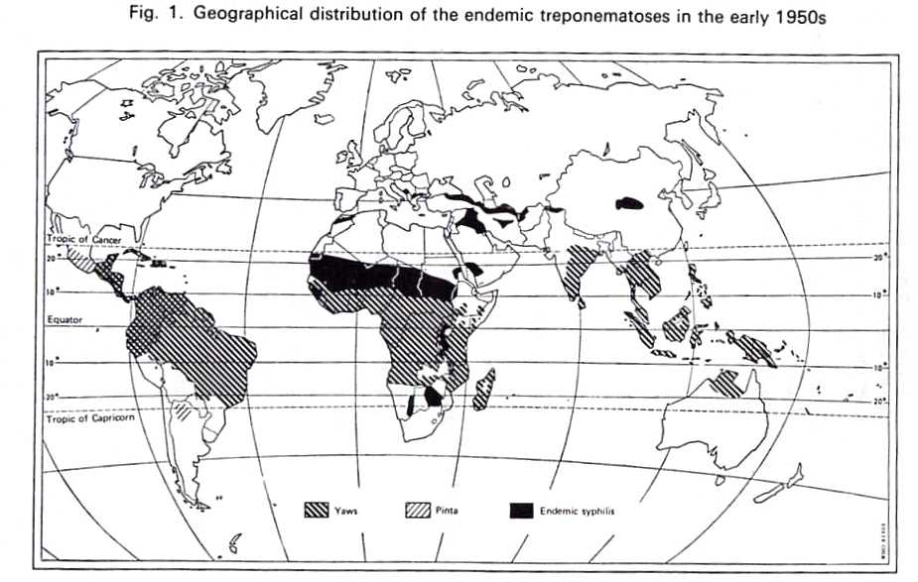
Notes:
This map shows the spread of the spirochaetal diseases in the 1950’s.
These diseases were all tropical.
Black = bejel and endemic syphilis
Hatched -= pinta
Yaws = stripe; moved from Africa to America with the slaves in the early 16th century

Slide 11
TREPONEMATOSES
Treponema spirochaete is a commensal of many animal species and the human mouth
21 Strains of Treponema pallidum have been defined and linked to various manifestations
Venereal Syphilis variant relates to American lines; probably from a mutation in Hispaniola
Endemic syphilis also called Bejel
Pinta
Yaws
Sibbons
Notes:
All treponemal infections give immunity to other treponemal infections
Thus a person with yaws, bejel or pinta has immunity to syphilis
Sibbons was a spirochaetal disease in Scotland and Scandinavia

Slide 12
Naples 1495
Alexander Benedetto, a papal doctor, reported that he had seen victims who had lost hands, feet, eyes, and noses because of the disease. Syphilis, he remarked, made "the entire body so repulsive to look at and causes such great suffering … that this sickness is even more horrifying than incurable leprosy, and it can be fatal.”
“were as thoughe they hadde lyen in fire”
Europeans were terrified by syphilis
Notes:
The development of a new venereal infection of many sailors on the returning ships indicates an infection acquired from the women of Hispaniola. not a mutation on the ship or in Europe
The rapid spread Worldwide to all countries including the isolated North American Indians indicates that no population had ever had earlier experience with syphilis.
The tenacious character of the syphilis spirochaete over the past 600 years until the arrival of penicillin is consistent with my contention that syphilis was never present anywhere before the mutation of the pinta spirochaete in Hispaniola

Slide 13
Sturt on the Murray 1833
“The most loathsome diseases prevailed throughout the tribes, nor were the youngest infants exempt from them.” and; “Syphilis raged amongst them with fearful violence; many had lost their noses, and all the glandular parts were considerably affected.”
Elsewhere, the 'chiefs' summoned up young men as displays, seeking Sturt’s explanation as to how this novel disease had come to the tribes
Notes:
Sturt C: Two Expeditions into the Interior. Vol 2.1833
Thesis by P J Dowling, ANU entitled “A Great Deal of Sickness” 1977 provides extracts from medical reports of syphilis in villages around Port Phillip
Visits of Aborigines to the European centers spread all diseases into villages that had not been contacted

Slide 14
Eyre syphilis Moorundie 1844 written in cryptic Latin and translated
“From that time very many were in a dying condition, some died and few, of those who associated frequently with them of any age or sex, were completely free from the signs of this disease.
“This illness seemed to appear among the natives in almost the same way as among Europeans but for various reasons was even more repulsive especially because round ulcers almost an inch in size erupted at the same time on the skin. The centre of these filled with puss seeping forth and as they grew larger and larger and spread the surface of the whole body was afflicted with putrefaction and scabs which aroused horror and revulsion in those approaching them.“
Notes:
Eyre E J: Journal of Discovery Vol 2. 1845
Eyre had visited this village in 1841 and everyone was healthy
Eyre was obviously distressed by what he found and did not want the detail to be spread to the general European community
Eyre also reported a village settlement where the bones of many lay around without traditional Aboriginal burial

Slide 15
SYPHILIS PANDEMIC
From Naples by land and sea in all directions over Eurasia from Ireland to Japan
From Iberia by explorers to all communities without yaws, bejel or pinta
Manifested as a killing disease from primary through to tertiary in months
Along with smallpox, influenza and measles caused massive depopulation
Notes:
In 1951 I treated a European in Kavieng with a primary chancre. This infection did not spread to the community even though the individual was living with New Guinea women
In the mid -1950’s every Papua New Guinean received a penicillin injection and Yaws was eradicated
In the late 1960’s a syphilis epidemic occurred mainly along the highway between Lae and Mount Hagen among the sexually active young people. The infection appeared to have originated from sailors visiting Lae

Slide 16
POPULATION DECLINE
Immunity muted killing epidemics but in many communities deaths still exceeded births
Decline of indigenous people was hidden by the increasing numbers of immigrants
People and missionaries noticed infertility or unusually small families
Truganini, the last Tasmanian, and her two female companions were infertile
Notes:
Other references
Bonwick J: The last of the Tasmanians. 1870
Cleland J B: Diseases among the Australian Aborigines. J. Trop. Med. Hyg. 1928
Butlin N G: Our own aggression. 1983

Slide 17
John Gunther to Bob Melrose
13th April 1950
“On Tabar Island I have started something - I doubt whether it will have any significance, but it might give some answers.
“We are giving every man, woman and child on Tabar 200,000 units of penicillin,…….
“We are giving all treatment for hookworm and a course of N.A.B. injections, and are placing anti-malarials at their disposal.”
Notes:
Bob Melrose was the pre-war Government Secretary who was on leave in Australia
This blunderbus therapy was set in motion immediately and Dr Augustus Schiessel detailed to carry it out. The treatment given also included a course of a sulphonamide.
This intervention made bacteriological studies of the infertile couples of no value.
At that time the effectiveness of a penicillin injection in the eradication of Yaws was being tested on Nissan Island

Slide 18
Gunther to Scragg June 9 1950
“This will confirm that it is the present intention that you should become District Medical Officer, New Ireland. The District is one where there has been a frank depopulation of 27% in twenty years.”
“Such a state of affairs needs early and rapid correction. Much research has been done there recently including a repeat demographic survey by Mr. Chinnery.“
Notes:
I was at Sydney University completing my DTMH course expecting to go to Rabaul or Sohano.
Declining population was not included in the demography section of the course nor did it include sociology or anthropology
At the same time new Australians bound for New Guinea were given lectures by Camilla Wedgwood on anthropology including depopulation.
These lectures conditioned Drs Mezaros and Zigas to consider kuru a psychosomatic condition

Slide 19
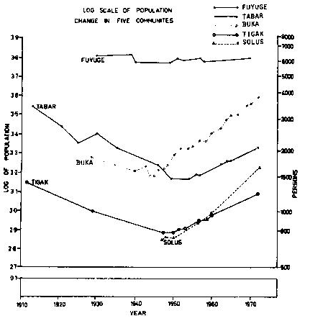
Population of 5 Communities
Notes:
TABAR TIGAK HAKU (Buka)
1908 8000
3483 1397
1930 2489 1006 1910
1940 1920 832 1580
1953 1466 814 2050
1972 2070 1220 3810
The depopulating populations of Tabar and Tigak responded to the penicillin campaign after 50 years of consistent decline.
Haku (northern Buka) had a similar decline caused by high mortality from 1930 to 1946 but minimal infertility and recovered quickly from the war.
The nadir was 1950 for all populations studied except for Fuyuge where significant seasonal malaria caused mortality to match fertility.

Slide 20
HYPOTHESES
The people blamed sorcery or deliberate consumption of reputed contraceptives or abortifacients plants.
Missionaries rejected sorcery but accepted the latter reasons.
Anthropologists postulated depression and despair resulting from the disruption of the traditional culture by the invaders and Christianity.
Medical administrators and native affairs officers were confused by opinions but agreed with anthropologists.
Doctors in active care of the people were frequently presented with genital and pelvic conditions in both sexes pathognomonic of gonorrhoea.
Notes:
WHR Rivers led the charge. He was a Cambridge psychiatrist who became an anthropologist after study of the Torres Strait islanders in 1898
His reputation made during the war was maintained in anthropology. In 1922 he wrote of his studies in New Hebrides where population decline was severe. Gonorrhoea was considered coincidental but the main cause was despair from the destruction of the pre-existing culture.
The Doctors who had worked in depopulating areas pre-war had disappeared and the post-war Doctors came under the influence of the anthropologists

Slide 21
PROMISCUOUS INTERCOURSE
Powdermaker noted in Malagan ceremonies New Ireland people would: “dance for several more hours, far into the night, which concludes with promiscuous intercourse. The only rule observed is the one of exogamy between members of the same moiety.”
Cook records that off Hawaii: "It was not possible to keep [the women] out of the ship and no women I ever met with were more ready to bestow their favours, indeed it appeared to me that they came with no other view."
Notes:
From 1840 New Ireland was between alternate sailing routes to China, the Philippines and India; there was also a whaling area to the north east.
The New Ireland women had a reputation for promiscuous behaviour
Coulter in the 1850’s reported aggressive behaviour by Polynesian women from other islands
New Ireland was the main island used by blackbirders for Melanesian labour

Slide 22
THE CONUNDRUM a psychosomatic phenomenon
“the physical causes were contributory to the wider psychological ones, or agencies through which these latter worked.
“But the root of the matter lay with that curious despair which dominated the native mind and coloured his every action and thought”.
Notes:
S H Roberts “Review of Depopulation” 1927 still taught in 1952
The German government was concerned at the declining population of New Ireland that they recorded from early in the 20th century.
It occurred on all islands as their inhabitants were easy to count and there was no confusion from immigration from adjoining villages
The blackbirding was of Melanesians for labour in Fiji, Samoa and Queensland . It was rare in Polynesia

Slide 23
ON THE CONTRARY a physical condition
Sailors infected with chronic gonorrhoea introduced this infection into the promiscuous New Ireland society and the Malagan ceremony primed an epidemic.
The failure to produce any children caused the ‘curious despair’.
Notes:
Raphael and Phyllis Cilento tried to discover the cause of depopulation in the western islands between Wewak and Manus. Their investigation was physical and linked the decline to nutrition and malaria

Slide 24
STUDY of POPULATION DECLINE
In New Ireland intercourse was a frequent event and conception should have occurred
The people of Kavieng were desperately changing partners but they got only ectopic pregnancies or nothing
For the first time in the 50 year study of popn. decline, there was an X-ray unit which enabled the investigation of female infertility
Notes:
My demographic study included population distribution, fertility and mortality and was compared with two groups of people I had studied on Buka Island in 1949.
This comparison disclosed that infertility in New Ireland was at least four times that in Buka
The X-ray unit was a relic from the army ANGAU unit distributed to the main hospitals

Slide 25
Responsible partner in infertile couples
 | WIFE | WIFE | WIFE | MALE
HUSBAND | Fertile | Sterile | Doubtful | TOTALS
Fertile | 11 | 29 | - | 40
Subfertile | 3 | 8 | - | 11
Sterile | 3 | 6 | 1 | 10
Divorced, dead | 2 | 5 | 2 | 9
Too Old | 2 | 5 | - | 7
FEMALE TOTALS | 21 | 53 | 3 | 77
No. Marriages | 11 | 57 | 9
% | 14 | 74 | 12
Notes:
I decided to investigate 80 infertile couples in the same manner as infertile couples were being investigated in clinics in Australia at that time. These investigations were intrusive but were accepted by the people as every family wanted children. The effectiveness of arsenic injections for Yaws had conditioned the people to believe that white man’s medicine was able to cure most diseases.
Infertility was not looked on as a disease but the traditional medicines they had tried had not provided the family they sought
The Rubens air insufflation test was equivocal so I decided to purchase a Hudgen’s cannula to investigate tubal patency. X-rays were taken after the injection and repeated the next day. The spill of dye onto the intestines indicated tubal patency.
Testicular biopsy was done on those without fertile spermatozoa.
Male infertility was present but not as significant.
At least 4 women became pregnant after this investigation

Slide 26
Buka and New Ireland 1953
Area | Women | Infertile | Stillbths | Dths 0-1 | Popn. Change 28 yr
L’koa | 94 | 4.3 | 26 | 71 | +154.0
Solas | 133 | 9.0 | 16 | 319 | +103.2
Tigak | 196 | 44.6 | 67 | 125 | -24.8
Tabar | 407 | 45.2 | 45 | 142 | -41.0
In Tigak and Tabar, 40% infertility rate was significant. In Solas, infant mort. was 32%, but depopn. did not follow as infertility was only 9%.
Notes:
This is the table selected by WHO to indicate the principle findings of my New Ireland study. The most significant finding was the high infant mortality n the inland villages of Solas. The same level of mortality was found in other studies in other inland areas
It has been suggested that chlamydial infection might have been the cause however chlamydia had not been identified as a cause of infertility in 1953. More relevant, Chlamydia is not sensitive to penicillin

Slide 27
Population of 5 Communities
Notes:
TABAR TIGAK HAKU (Nth Buka)
1953 1466 814 2050
1972 2070 1220 3810
2000 4170 now urban 8175
The health measures applied in all districts and in particular vaccination, anti-malarials, sulphonamides and antibiotics along with infant and maternal welfare services significantly lowered mortality.
Effective treatment of gonorrhoea and the disappearance of traditional child spacing enhanced fertility.
There was no fertility transition even though contraceptives were available from maternity clinics.

Slide 28
INFERTILITY from GONORRHOEA
WHO expert committee 1975 opinion: “The most complete epidemiological study on the prevalence of infertility, pregnancy wastage, and child loss is that by Scragg on New Ireland in the West Pacific. This study combined a demographic survey and clinical diagnostic studies on defined groups of women”.
Notes:
WHO Technical Report Series No. 582: The Epidemiology of infertility. Report of a WHO Scientific group. Geneva 1975
This comment indicates the seminal nature of my study. This same opinion was also expressed by other authorities on the subject
The world wide use of penicillin for Yaws eradication and treatment of infections made it impossible for this study to be undertaken anywhere else in the world; it had to be done when it was done or it could not be done
In 1960 Professor Peter Pirie of the East West Centre read my thesis . He then confirmed the impact of gonorrhoea in Hawaii and eastern Polynesia

Slide 29
AMERICAN BLACKS
“The effects of the prevalence of venereal disease are now difficult to gauge, but it must have blighted hundreds of thousands of black families.
“Instead of 26 million, the number of blacks recorded by the U.S. census in 1980, the black population, without the "involuntary infertility effect," would probably have been at least 45 million.“
Notes:
Wright P & Pirie P: A false fertility transition: the case of American blacks. Paper of the East West Population Institute No. 90. February 1984
Pirie ,Professor of Geography University of Hawaii ,only realised the significance of gonorrhoea when he read my thesis on depopulation in 1958.
With Wright, Professor of Earth Sciences ,Pirie was able to separate and correlate fertility statistics of American Blacks in South Carolina, Georgia, Florida, Mississippi, Alabama and Louisiana.
It is probable that the same phenomenon occurred in other countries and societies, either in a particular group or as a whole.

Slide 30
SILENT PANDEMIC
Over time the impact of epidemic gonorrhoea was as significant as smallpox as it continued to gnaw away at communities year after year
The many infections passed unnoticed but the permanent sequelae were epidemic. The word ‘Gonorrhoea’ does not appear in McMichael’s world epidemiology
If gonorrhoea had not been identified as the principal cause of population decline in 1953, the persistent decline would have gone down in world history as a psychosomatic phenomenon
Notes:
Where venereal disease was mentioned by lay observers it was one that could be seen without investigation such as syphilis and granuloma venereum
Gonorrhoea came, did its damage then the individual considered themselves cured. However conception failed to occur in an apparently healthy woman
Gonorrhoea was in due course implicated as a cause of infertility in most countries in the developing world and by inference caused population decline throughout the southern hemisphere and North America during the process of invasion and occupation over the 400 to 100 years until penicillin was discovered.
The impact of gonorrhoea has long been under estimated.

Slide 31
PENICILLIN then the PILL
The amount of promiscuous behaviour set the prevalence of gonorrhoea in any society
Gonorrhoea was more effective than the condom or any other contraceptive in limiting population growth in many countries
Penicillin was universally available from 1950 and reduced pelvic infections in pubescent women and new brides became pregnant
Notes:
Penicillin came into general use when the war finished. It was more efficient than the sulphonamides in curing gonorrhoeal infections
The contraceptive pill became generally available in 1960. Its use was and still is strongly rejected by the Catholic Church.
In PNG the national leaders rejected the pill as they considered a rapid increase in population would be of more value than a slowly growing community.

Slide 32
1960s POPULATION SPIRAL
Penicillin lowered mortality and reduced the incidence of gonorrhoea raising fertility and opening the population flood gates in all countries where its use was not succeeded by a significant adoption of the contraceptive pill
Notes:
It may not be possible to prove this final statement. It is based on the change of fertility that Pirie was able to identify in American blacks matching the detailed microcosm of my studies in New Ireland
In Tabar the population nadir was in 1951 the year after mass penicillin that eradicated gonorrhoea and yaws.
After 15 years the annual population increase in New Ireland matched then exceeded that of PNG as a whole.

Slide 33
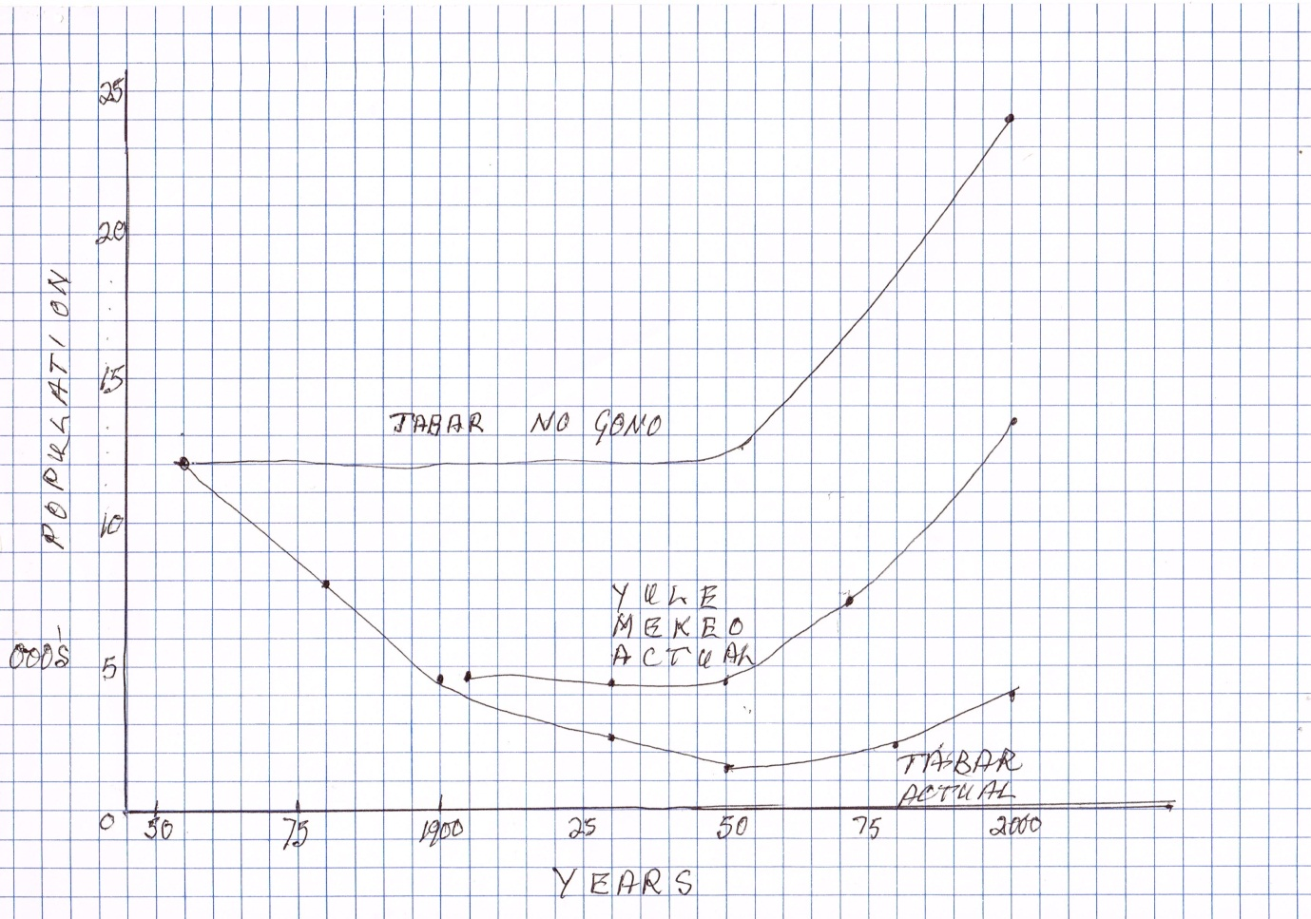
Notes:
A hypothetical projection of the Tabar population if there had been no infection with gonorrhoea during the 19th century based on the recorded population change in the Papuan areas where there was no gonorrhoea endemic and also compared with the actual population change in Tabar.
The gradient matches the worldwide projection of population of the developing world.

Slide 34
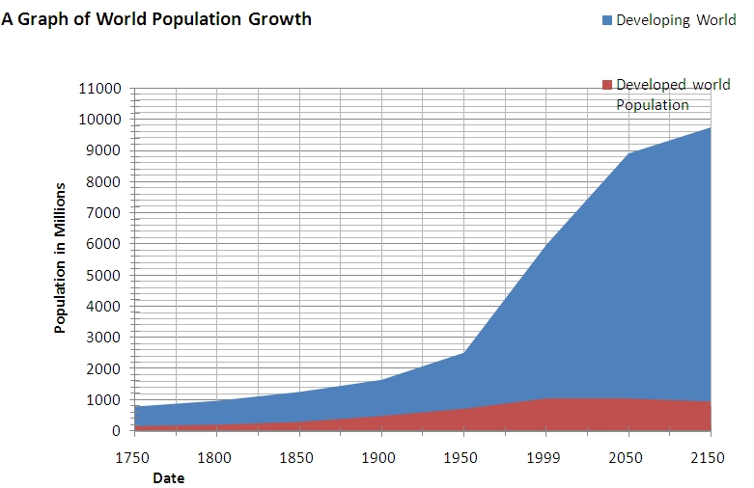
WORLD POPULATION
Notes:
The world population growth took off after 1950, this is defined in Australia as the “baby boom”. The change in the population in Australia is included in the developed world where the widespread use of the contraceptive pill was widespread
The rate of growth of the developing world exceeds the rate of growth from the baby boom in spite of the inclusion of China with a one child policy within the developing world.
Two factors have worked together world wide
The initial postwar baby boom associated with the rising number of new couples
and
The effective treatment of gonorrhoea the principle controller of population growth over the centuries from the Iberian invasion of the southern hemisphere during the 16th century through to the middle of the 20th century

Slide 35
ADAM and EVE
Whether man was created or evolved he had the reproductive potential to produce unlimited progeny who would eventually exceed the food production of the globe.
Over the centuries disease and pestilences; man made and environmental disasters; wars and genocide acted as a damper protecting man from the ultimate disaster

Slide 36
ANCESTORY
Before 1500, cities, ports and sailors were endemic foci of gonorrhoea. Columbus added Syphilis.
Infertility of queens and commoners came from gonorrhoea when husbands infected wives
Total or 1 or 2 child infertility caused family lines to disappear but mistresses were often fertile
The uninfected with many offspring populated the medieval world in the same manner as those who today use no contraception and multiply at twice the rate of contraceptive users
Notes:
Catholics and Muslims in all countries apply ineffective methods of birth control and their proportion related to the rest of the community is a microcosm of the world scene when one compares developed and undeveloped population growth

Slide 37
DAMPERS of REPRODUCTION
Infant death and infanticide
Post partum infection and maternal mortality
Under nutrition reducing gestational span
Harems and polygamy
Lactational and social continence
Gonorrhoea and chlamydia
Male absence in wars and on social tasks
Notes:
An adequately nourished women has a gestational span of 30 years
Unimpaired familial intercourse with lactational control of ovulation results in a birth every 16 months.
Women with multiple multiple births have produced over 50 children

