Slide 1
EN CLAIR ORIGINATOR R.G.A.J. JACKSON FROM UNRRA (LONDON) TO 21 ARMY GROUP EXPOR FOR C.A. UNRRA
12.30 pm 21.8.1945 Important
Please pass the following to CILENTO, UNRRA from JACKSON
Begins; PERSONAL
1, The Director General has requested me to ask you whether you would be willing to assume the appointment of Chief of UNRRA Operations in the British Zone of Occupation. We both feel confident that you will carry out this appointment with success and distinction and it is hoped that you will agree to assume this appointment.
2. Mr Bruce, High Commissioner for Australia, has also indicated that the assumption of this appointment would be a matter of satisfaction to the Commonwealth Governments.
“One can well imagine what were Cilento's innermost thoughts and feelings as he read, and re-read, those heartening words of vindication and challenge, and savoured alone the bitter-sweet taste of condign justice. Australia's endorsement of his appointment would have raised his proud spirits even though recognition of his distinguished service came in respect of work in far-off Germany.”

Slide 2
RAPHAEL WEST CILENTO
MEDICAL ADMINISTRATOR, LEGISLATOR, AND VISIONARY
1893-1985
Fedora Gould Fisher
A thesis submitted to the Department of History University of Queensland for the degree of Master of Arts April 1984 https://espace.library.uq.edu.au/view/UQ:189754/the3072.pdf
Notes:
Fedora Fisher knew the Cilento house, lived nearby.
1974 Brisbane floods; Cilento 2 story home had RWC’s ground floor library flooded. She helped the recovery of books , documents and papers from the mud and also as a conservator at UQ which led to her thesis on RWC
The link is to the Thesis

Slide 3
Cilento Family Tree
      Salvatore Cilento 1831-1914= Elizabeth Watson 1831-1878
Raphael Ambrose Cilento 1865-1945 = Francis Ellen Elizabeth West 1868- 1956
Raphael West Cilento 1893-1985 = Phyllis Dorothy McGlew 1894-1987
Alan West
Raphael C F
Phyllis M
Ruth A Y
Carl L
Elizabeth Dianne
David
four are doctors, one an artist of international repute, and one is well-known stage and screen
Notes:
Prominent shipping family in the Italian Province of IlCilento,
Salvatore and 2 brothers fought in the rebellion; the First Italian War of Independence in 1848. They were routed and death penalty proclaimed by the King of Naples on participants. The 3 boys were smuggles to England on a Company vessel. One went to USA, one returned to Italy and died of Typhoid and Salvatore went to Australia as crew on board an English trader Telegraph, the ship was quarantined, he escaped, was hospitalised in Adelaide, when recovered the ship had sailed…........January 1855
Good Colonist,Married with 7 children, loyal to Q Victoria, lightering business at Port Alaide.
Son RAC, aged 15 and economic downturn, left school, joined the SA Railways, States youngest Stationmaster, Good connections, Freemasons and the Bishop. Bacamse a strong Anglician and member of the Synod and cheif Organiser of the protestant Party in 1927. He has become a zelot

Slide 4
Salvatore Cilento. 1831-1914
aged 17 joined the 1st Italian War of Independence in 1848
Death Penalty
aged 24, Adelaide with Typhoid, January 1855
never spoke of his Italian heritage to his children again
became an enthusiastic and loyal Colonist
married with 7 children
successful lightering business in St Vincent Gulf
aged 60’s, 1890’s recession
Notes:
3 boys enlistwd

Slide 5
Son of Salvatore
Raphael Ambrose Cilento,1865-1945
aged 15, due to economic downturn, left school
joined the SA Railways, States youngest Stationmaster
aged 26, married Francis Elizabeth West daughter of the Mayor of Burra.
aged 36, selected as Liberal Party candidate for the Legislative Council
aged 47 , chaired and founder of the first Railway Institute in SA

Slide 6
Son of Salvatore
Raphael Ambrose Cilento,1865-1945
Freemasons and the Catholic Bishop
aged 62, became a strong Anglician and member of the Synod
chief Organiser of the Protestant Party
He had become a zelot
“No member at a Federal,
State, Municipal, Union
or other election
shall vote for any
Roman Catholic
candidate.
This State, at least must be kept free from Popery and Priestcraft”

Slide 7
and now the elder son
Raphael West Cilento 1893-1984
the pattern of family life is set in the mould of the Australian bush,
the local solicitor, Frederick Young,
“I stood a little in awe of my handsome, peremptory father and I knew I must displease him. But I had determined to become a doctor and intended to see it through.”
aged 13,to earn his secondary education he joined the Education Department as a cadet teacher,
aged 14 he left home to enter the Teachers' Training College (Adelaide High School)
aged 15 and 16 passed Junior and Senior Public examinations in consecutive years
aged 17,1910, was posted to Port Pirie school for two years final training.
Notes:
in a secure and lively home where the limitations of the breadwinner's wage were transcended by hard work and the enjoyment of shared activities.
a seven year course which he began at Jamestown school as a monitor in 1906. He was paid 12/6 per week,

Slide 8
Son Of Raphael Ambrose
Raphael West Cilento 1893-1985
Aged 18 , 1911 graduation as a teacher
  his teaching course had precluded the science subjects
Recalling Port Pirie days, he wrote of “shabby clothes and no girls, of trundling ore in banana carts (long barrows) at the smelters and burning the midnight oil writing for newspapers to extend meagre funds and pave the way for matriculation into medicine.”
Recalling Port Pirie days, for recreation he formed a Scout Troop and took up boxing, wrestling and public speaking, none of which required money.
his only hope was to win a government bursary, rare and coveted,
His father who at some personal sacrifice, helped him financially at this time.
He entered Prince Alfred College as a boarder to attempt in ten months, three years work in subjects quite new to him.

Slide 9
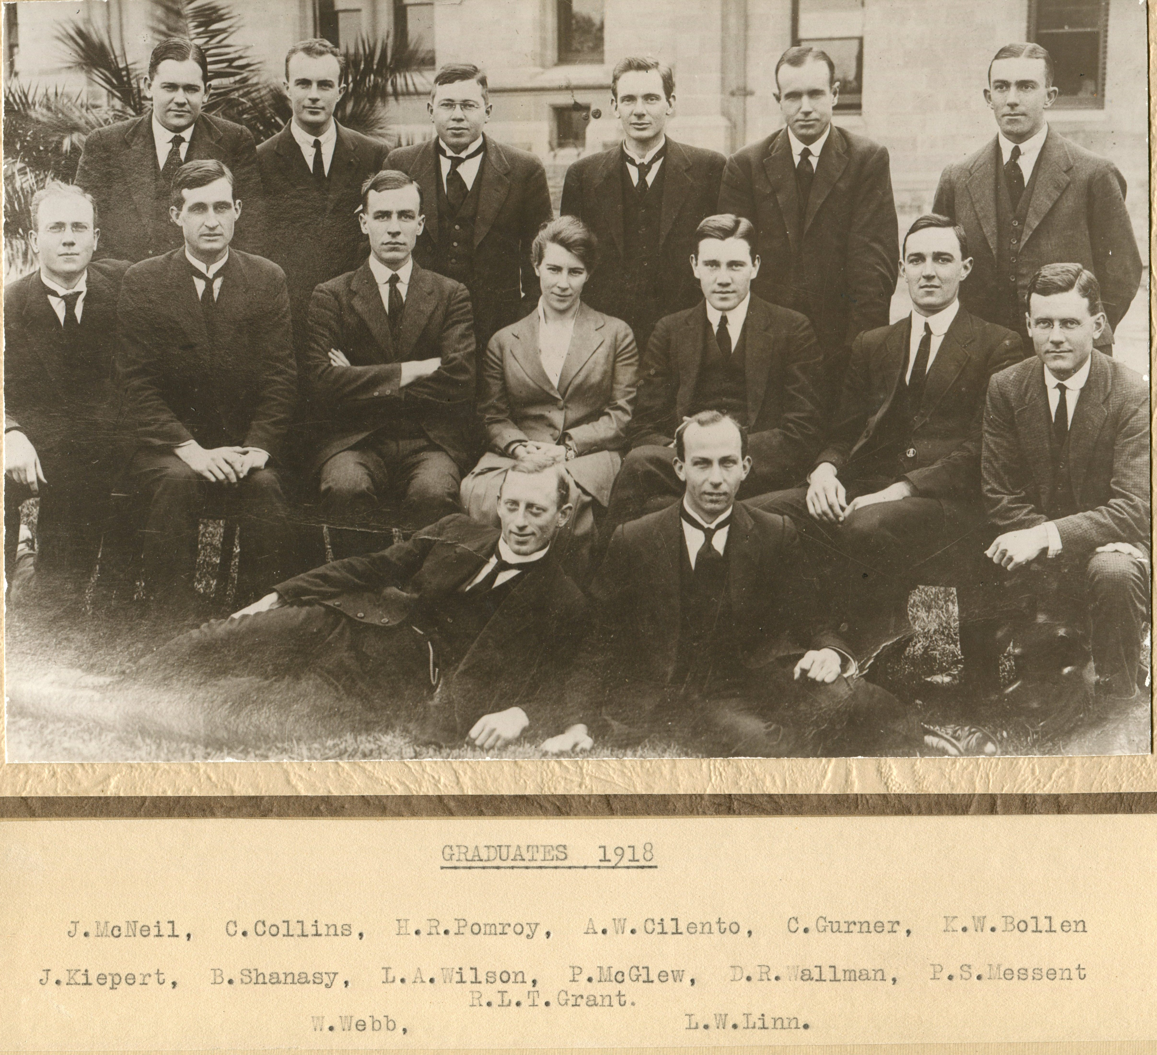
Raphael West CILENTO.
1893 – 1985.
Medical Student
He not only passed but had saved enough money to pay for his 'pre-med' year and put a deposit on his medical course.
Aged 21, in 1914, with a loan of fifty pounds from Dr William Aitken, the last of the Jamestown giants who had brought Raphael into the world and who inspired within him the ambition to become a doctor.

Slide 10
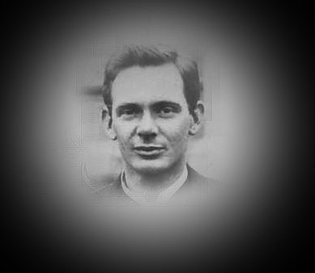
Raphael West CILENTO.
1893 – 1985.
Medical Student
aged 22, in 1915 applied to the AIF, endorsed for Home Service
aged 23, in1916 performed Home Service with 61 days as surgical dresser Murray Bridge, War Service Camp.
Discharged as “Reduction of Establishment” as Cpl Cilento
Enter, Harold Leslie BOYCE, 1895-1955
aged 25, June 1918 “call up” for active AIF service and given leave of absence to finish his course.
November 1918 appointed:
Capt AAMC, AN&MEF

Slide 11
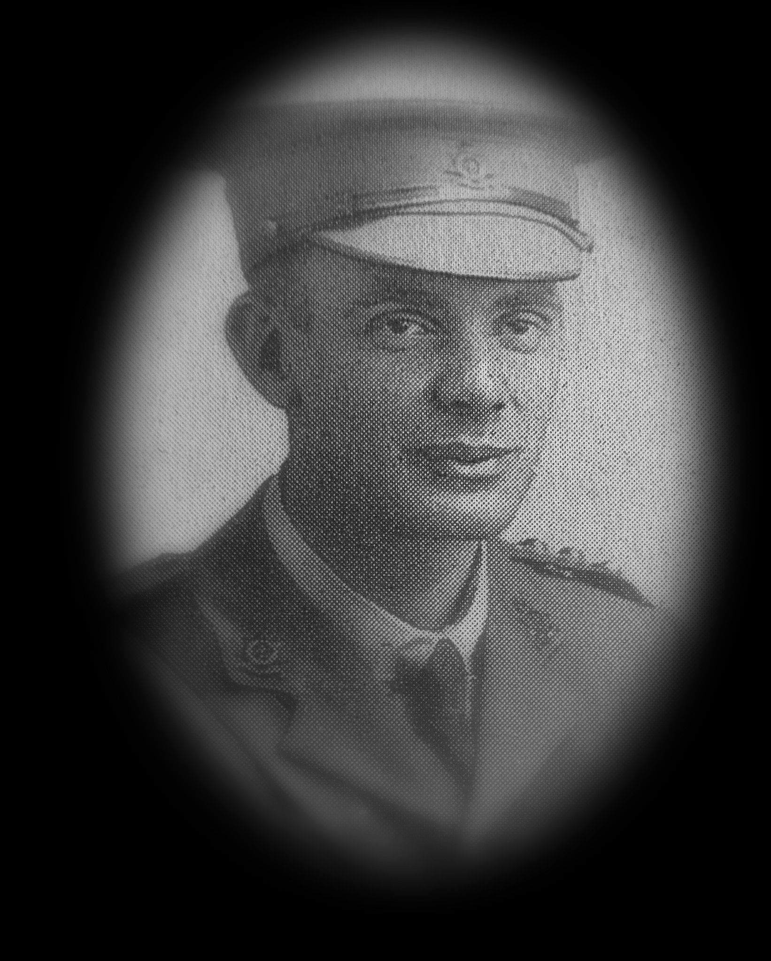
Capt. R W Cilento MB BS,AAMC
Embarked from Sydney for Rabaul on 18th December
Studied and reported on Tropical Medicine
Returned to Australia with appointment
terminated on the 18th October 1919
not eligible for War Medals
“ the AN&MEF were in New Guinea as the
British military occupation” until 1921.

Slide 12
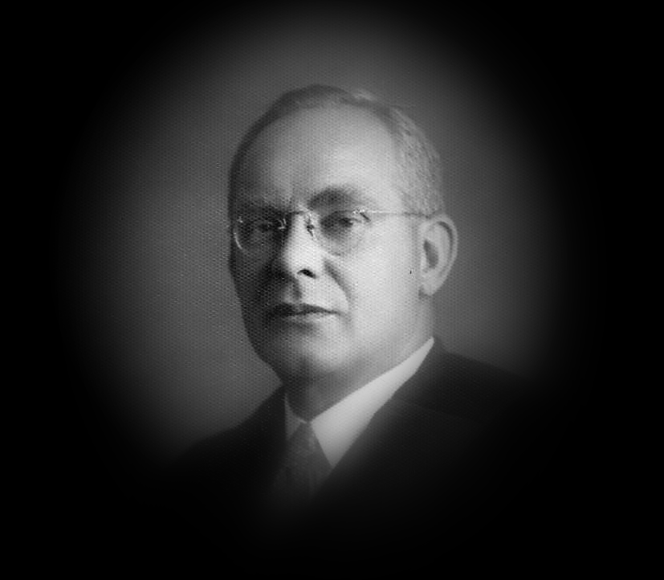
Sir Raphael West Cilento. MD BS
Consultant Physician to the Sultan of Parak, Federated Malay State.
Director of the Australian Institute in Tropical Medicine
Director of Public Health for the Mandated Territory of New Guinea
Notes:
Phyllis the 1st female Dr in Colonial Service
Muslim community

Slide 13
Sir Raphael West Cilento. Kt, MD BS LLB
Director of Tropical Hygiene and the Chief Quarantine Officer in Brisbane
State Director-General of Health and Medical Services and Home Affairs in Queensland.
major role in the establishment of a Medical School within the UQ
aged 42 appointed Knight Bachelor
aged 46 Barrister of Law

Slide 14
Sir Raphael West Cilento. Kt, MD BS LLB
aged 34- 40 (1920-1926), AAMC Reserves
Hon. Lieut Colonel 1st MD. 1937
WWII 1939-1945; Internment, Cairns.
aged 44- 52 (1937-1945), Hon. Professor Social and Tropical Medicine, University of Queensland

Slide 15
Sir Raphael West Cilento. Kt, MD BS LLB
“As Director General of Health and Medical Services he was believed by the organised medical profession to be involved in the destruction of the powers of the honorary doctors in the public hospital system. “
“As a public servant advising the Commonwealth government he produced an administrative structure for one of the earliest attempts to introduce national sickness insurance into Australia.”
“The profession's resentment of the government's intrusion into this area was directed at Cilento personally.”
“Reasons are given why this was both odious and unjust.”

Slide 16
Sir Raphael West Cilento. Kt, MD BS LLB
aged 52,in 1945:
“No one seemed to want him in Australia but he knew that with war in Europe about to end there was urgent work to be done in the war zones if postwar epidemics were not to take an even greater toll of life than hostilities had done.”
“The request for his services had come from the United States government to the Commonwealth authorities and they in turn had asked the Queensland government to allow Cilento twelve months' leave of absence for the task.”
“He was therefore delighted to receive and accept an invitation from the United Nations Relief and Rehabilitation Administration to become, under its aegis, malariologist in chief to the Balkans.”

Slide 17
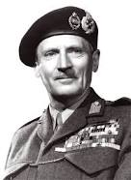
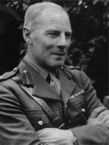
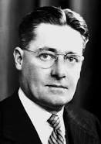
Field Marshal Bernard Law MONTGOMERY
1st Viscount Montgomery of Alamein
KC, GCB,DSO,PC
Brigadier Sir Hugh William CAIRNS
MB BS Adelaide 1917. DM, FRCS
KBE
Baron Howard Walter FLOREY
MB BS Adelaide 1921. FRS,FRCP
OM
Sir Raphael West CILENTO
MB BS Adelaide 1918.MD, DTM&H (Eng), F.R.San.I. (Lond.)
Barrister-at-Law
Kt
Notes:
Some co incidence that the British Army sent a young Medical Officer from Yorkshire to work with the new Unit of Cairns at Oxford and who was in the *th Army in North Africa when his Unit and Florey’s Unit went to North Africa
The young MO later was the first Professor of Surgery Prof Dick Jepson…..... From his wife Mary Jepson.

Slide 18
Sir Raphael West CILENTO.MD, DTM&H (Eng), F.R.San.I. (Lond.)
Barrister-at-Law
“Bernard Law Montgomery and Raphael West Cilento, two vastly different men
but
both were totally dedicated to their respective professions
both were born to be decision-makers
both had responsibility in circumstances that could mean life or death to millions of people
both relied upon skilful organisation and tight control of staff

Slide 19
Sir Raphael West CILENTO.MD, DTM&H (Eng), F.R.San.I. (Lond.)
Barrister-at-Law
Cilento wanted total authority in his sphere.
Montgomery recognised in Cilento qualities indispensable to the task in hand; these he attributed to Cilento's legal training.
Montgomery’s plan was for full scale demilitarisation and relocation of all the displaced persons in the British Zone decided to back his new medico-legal administrator
Cilento entered Montgomery's office a Lieut-Colonel and emerged, slightly dazed, with the (assimilated) rank of Major General.

Slide 20
Sir Raphael West CILENTO.MD, DTM&H (Eng), F.R.San.I. (Lond.)
Barrister-at-Law
Signal from Commander Jackson RAN
EN CLAIR ORIGINATOR R.G.A.J. JACKSON FROM UNRRA (LONDON) TO 21 ARMY GROUP EXPOR FOR C.A. UNRRA
12.30 pm 21.8.1945 Important
Please pass the following to CILENTO, UNRRA from JACKSON
Begins; PERSONAL
1, The Director General has requested me to ask you whether you would be willing to assume the appointment of Chief of UNRRA Operations in the British Zone of Occupation. We both feel confident that you will carry out this appointment with success and distinction and it is hoped that you will agree to assume this appointment.
2. Mr Bruce, High Commissioner for Australia, has also indicated that the assumption of this appointment would be a matter of satisfaction to the Commonwealth Governments.

Slide 21
Sir Raphael West Cilento. Kt, MD BS LLB
“One can well imagine what were Cilento's innermost thoughts and feelings as he read, and re-read, those heartening words of vindication and challenge, and savoured alone the bitter-sweet taste of condign justice. Australia's endorsement of his appointment would have raised his proud spirits even though recognition of his distinguished service came in respect of work in far-off Germany.”

Slide 22
Major General Sir Raphael West Cilento. Kt, MD BS LLB
1893 – 1985.
aged 55 in 1948, as World Director of Social Security for the UN, with Count Bernadott negotiated for a State of Israel and disaster relief in Palestine.
Notes:
1945 recruited for the public health and malaria in the Balkans
1964 …the malaria research facilities were still operational in Rabaul

Slide 23
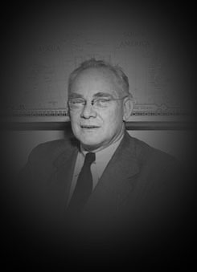
Major General Sir Raphael West Cilento. Kt, MD BS LLB
1893 – 1985.
aged 60 +,after UN appointments; General Practice, Sunshine Coast and Brisbane
President of the Royal Queensland Historical Society
President of the National Trust of Queensland
Official History of the Australian Army Medical Services (1914-1918):
Vol 1,Par111. by F A Maguire and R W Cilento

Slide 24
Sir Raphael West CILENTO.MD, DTM&H (Eng), F.R.San.I. (Lond.)
Barrister-at-Law
“Cilento's major fault was an inability to discern what was feasible at a given time, be it in medico-politics, politics or public service life.
In his determination to achieve results quickly, he was intolerant of the views and difficulties of his opponents. This could adversely affect his working relationships with superiors.
He was ambitious and had a propensity to centralise power.
His insatiable curiosity and vitality were fuelled by a constant stream of new ideas.
He loved to institute reforms but lacked the patience to consolidate these by routine.
He was always looking for fresh fields to conquer.”

Slide 25
Sir Raphael West CILENTO.MD, DTM&H (Eng), F.R.San.I. (Lond.)
Barrister-at-Law
Harold Leslie BOYCE 1st Baronet KBE, KStJ.1895-1955
born on 9 July 1895 at Taree, New South Wales,
a medical student, he enlisted in the AIF while on holidays in Adelaide in March 1915.
promoted lieutenant in the 10th Battalion and seriously wounded at Pozières in July 1916.
Invalided back to Adelaide .
After the war Boyce went to Balliol College, Oxford, B.A., 1920; M.A., 1924. he read for the Bar and in 1922 was called to the Inner Temple.
Boyce entered the House of Commons as Conservative member for Gloucester in 1929
became an alderman of the City of London in 1942,
high sheriff in 1947-48
in 1951-52, lord mayor — the first citizen of a dominion to achieve the distinction.
“His many friends included Leo Amery, Viscount Bruce, (Baron) Casey and the Cilento family”
ADB : vol 7, 1979.

Slide 26
Raphael West Cilento
1893-1985
During his last days he spoke to his family and informed them that he had converted to be a Catholic.
One son said he was an old hypocrite.
He responded
“They might be right.”
Exploring to the end

Slide 27
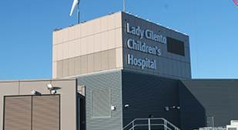
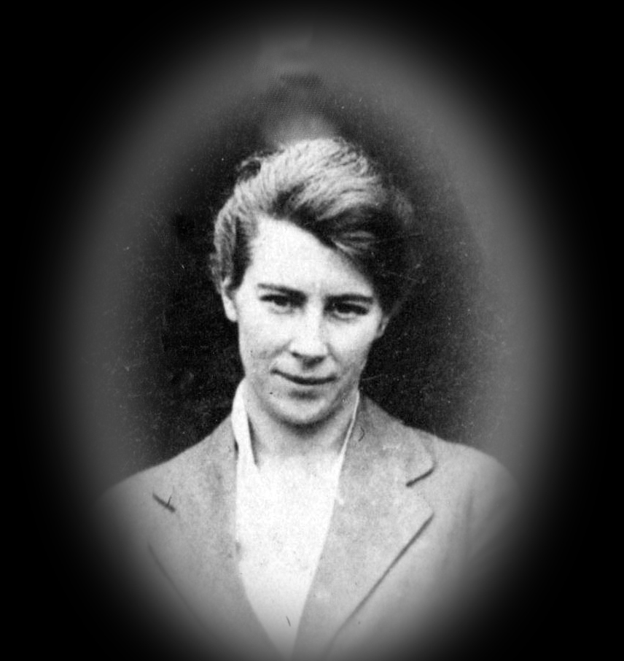
Lady Cilento Children’s Hospital , Brisbane . June 2014
Dr Phyllis McGlew, 1894-1987. MB BS Adelaide.1918.
Aka. Lady Cilento

