Slide 1
ACKNOWLEDGEMENTS
ADJUNCT PROFESSOR SUSAN MAGAREY
PROFESSOR DONALD SIMPSON
RAYMOND PAULL

Slide 2
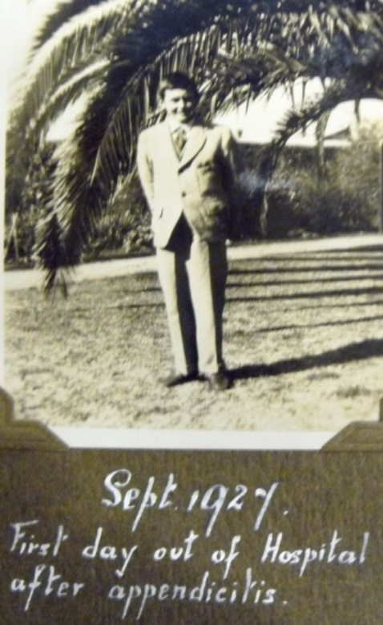
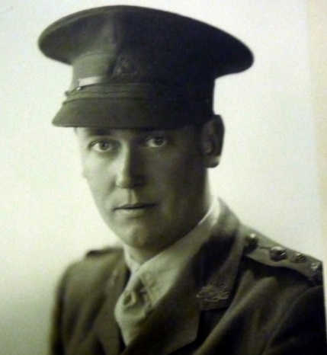
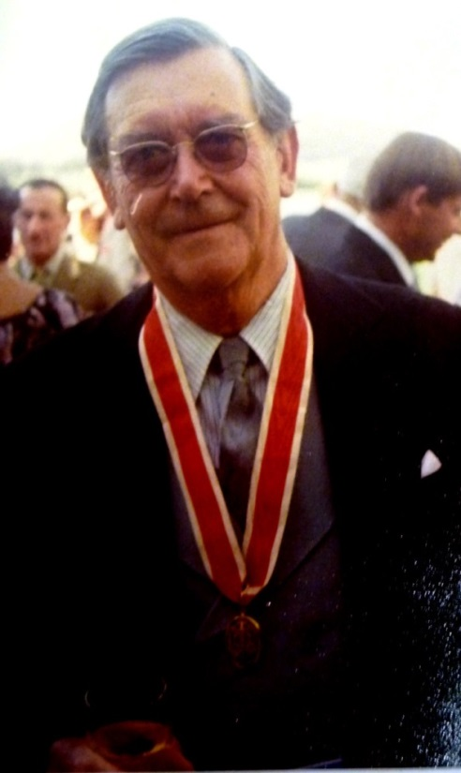
RUPERT JAMES (BOB) MAGAREY
1914- 1990
Surgeon, Teacher, Kokoda Trail Veteran, Negotiator To End The Honorary System

Slide 3
Three photographs at various ages. One as a student aged 13 at St. Peters college.
Aged 25 after graduation and joining the AIF.
At his investiture in 1979.

Slide 4
MAGAREY FAMILY
Ancestors
FAMILY ARRIVED IN SOUTH AUSTRALIA 1840s
They are responsible for Two Different Magarey Medals
Great Uncle William - 1897 in football “Best and fairest”
Daughter Susan- 2004 Literature: Women Biography 2004
Graduated MBBS 1938
Married Catherine Mary Gilbert April 1940
War Service
Sailed for Middle East: August 1940
Served In 2/11 Australian General Hospital, Syria
Mentioned In Dispatches December 1940
Transferred To New Guinea 2/6 Australian
Field Ambulance Kokoda Track in 1941

Slide 5
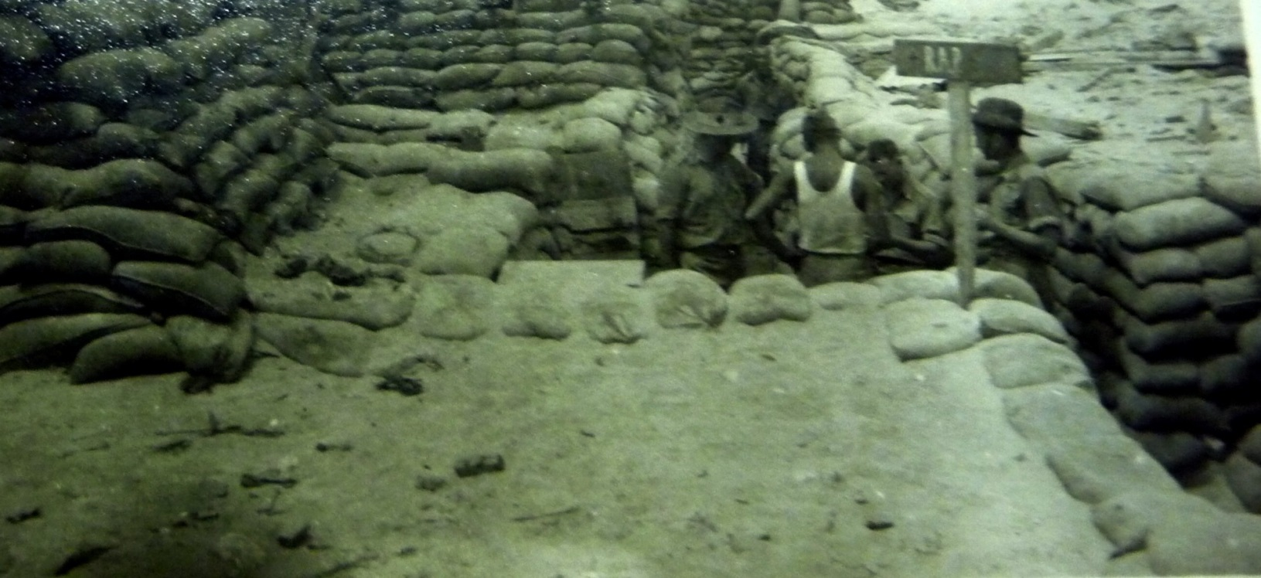
REGIMENTAL AID POST SYRIA
Enemies were Vichy France

Slide 6
Professor Simpson kindly pointed out that after WW1 Syria became a Protectorate of France. During the German invasion in 1940 the Vichy Government became responsible for Syria, and the Allies faced the French. Captain Magarey was mentioned in dispatches and Raymond Paull refers to him as Major in in his book. When Japanese threat to Australia increased the 7th division of the AIF was recalled home.

Slide 7
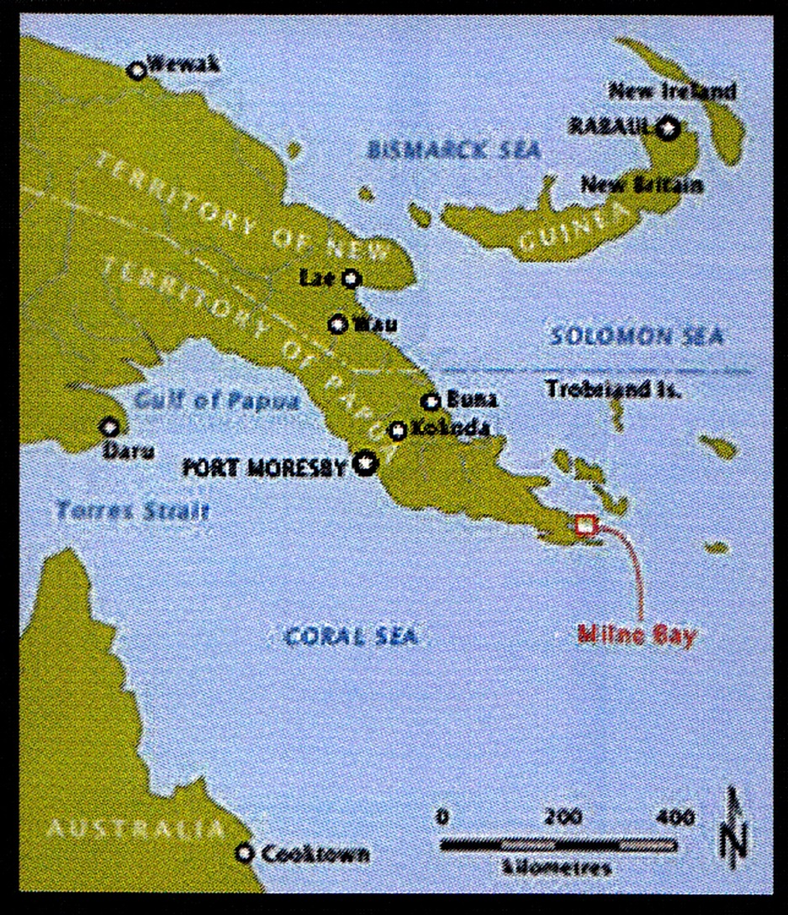
MAP OF NEW GUINEA
CORAL SEA BATTLE 4-8/5/1942
KOKODA 21/7/42 TO 1/4/1943
MILNE BAY 23/8/42 TO 7/9/42

Slide 8
The battle of the Coral Sea lasted 4 days and severely damaged Japanese sea power. In order to get bases closer to Australia Japan decided to conquer New Guinea. They first landed in July at Buna to reach Port Moresby by land using the Kokoda trail.
They hoped to open a second front by landing at Milne Bay. Fortunately this failed.

Slide 9
After landing at Gona and Buna the Japanese were at Kokoda in seven days. Australians were un-prepared and low in manpower and supplies.
Major Magarey was involved in retreat from Isurava, Myola and Efogi. The medical help involved mainly the safe evacuation of the wounded.
By the time the front reached Ioribaiwa, the Japanese supplies were failing and the proposed final battle at Imita Ridge resulted in their retreat.

Slide 10
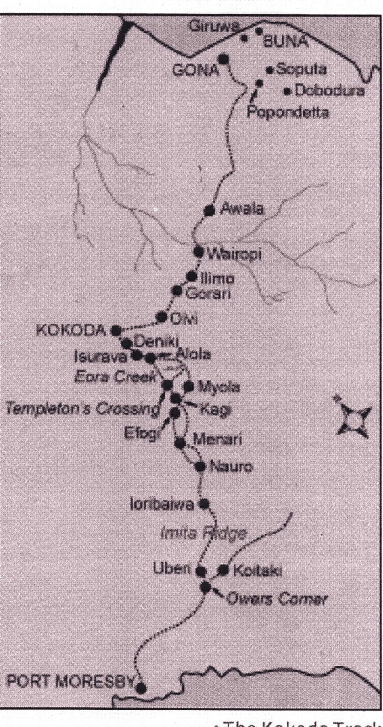
  21-7 1942
Japanese land at Gona and Buna
28-7
Kokoda taken
Isurava Alola Elogi evacuated
23-8
Milne Bay invasion
16-9
Ioribaiwa to
Imita Ridge
2-11
Kokoda recapture

Slide 11
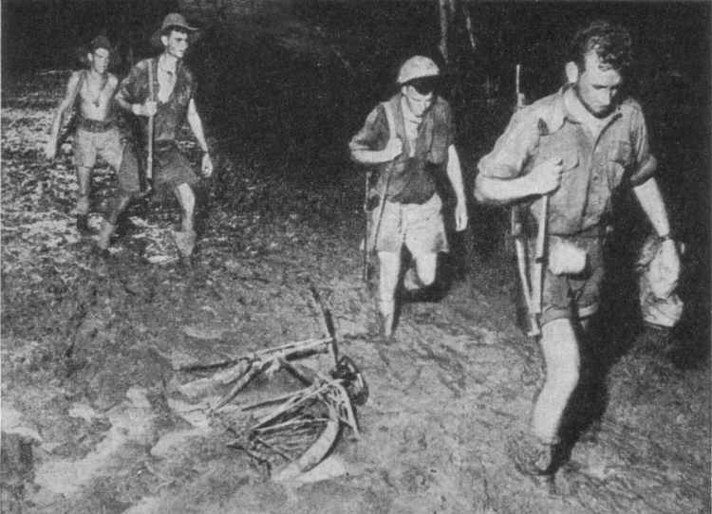
KOKODA PATROL

Slide 12
Both Australians and Japanese used patrols to the detect main enemy forces and to prevent encirclement or attacks from the sides. By the time the Japanese reached Ioribaiwa the one of their patrols could see Port Moresby

Slide 13
2/6 FIELD AMBULANCE
TREATMENT AND TRANSPORT OF WOUNDED
2 OFFICERS 30 MEN
ADVANCE DRESSING STATIONS
INCREASES IN MEDICAL STAFF AND AIR EVACUATION WERE NOT POSSIBLE

Slide 14
MAGAREY DIARY
TOPICS DISCUSSED IN Mjr MAGERY’S DIARY
    WALKING WOUNDED AND SICK
    NATIVE STRETCHER BEARERS
    WOUND CARE AND SURGERY
    INDEX OF EQUIPMENT, ACCOMMODATION
    MALARIA, DYSENTERY
    MALINGERING, “SIW”

Slide 15
Major Magarey destroyed his diaries at Alola as the Japanese advanced. He rewrote them later and Professor Susan Magarey allowed us access. His main comments involved that the bearers should be managed with compassion and by people who had local knowledge. He encouraged the injured to walk if possible and was insistent on hygiene and foot care. Changes of dressings were frequent and sulphonomides were used.

Slide 16
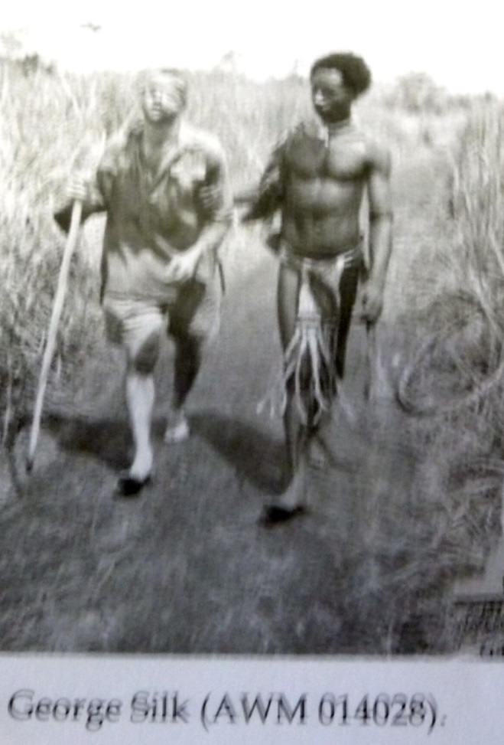
FUZZY WUZZY ANGELS
BRINGING BACK THE BADLY WOUNDED
JUST AS STEADY AS A HEARSE
USING LEAVES TO KEEP THE RAIN OFF
AS GENTLE AS A NURSE
Bert Beros’ verse October 1942

Slide 17
As the victory in New Guinea became likely, the mainland press published a photograph of a native helping a blinded soldier to a first aid station, near Buna. A poem by Bert Beros called the “Fuzzy Wuzzy Angels” glorified the native bearers and perhaps starting the Kokoda tourism.

Slide 18
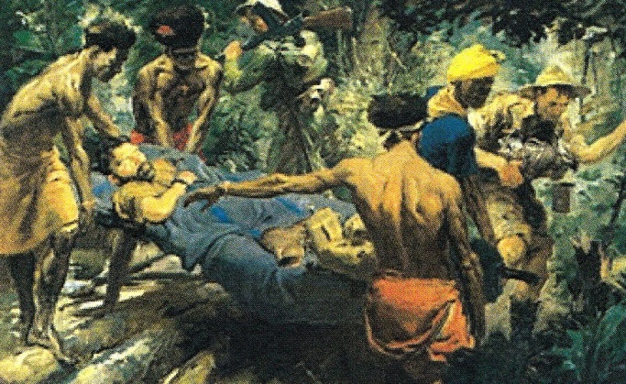
KOKODA CAMPAIGN
William Dargie 1943

Slide 19
William Dargie was a war artist. His painting shows the stretcher, one bearer at each crossbar, replacements bearers, support personnel and a supervisor. The items on his lap are a boot and a water bottle.

Slide 20
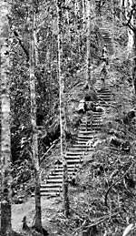
Kokoda stairs

Slide 21
The Golden stairs was the name of about 900 stars near Imita Ridge. They were climbed by the soldiers on the way to the front. They were overgrown after the war and restored later. A similar set of stairs in Stanley Park in Perth is used by tourists training to visit Kokoda trail.

Slide 22
AUSTRALIAN CASUALTIES: JANUARY 1942-1943
Battle of Kokoda: 1647
Killed in action 491
Death from wounds and missing 133
Wounded in action 1023
Battle of Milne Bay: 377
Killed in action 167
Wounded 205
Missing 5
Battle (1943) to expel the Japanese from Buna and Gona: 1267
Killed 967
Died of wounds 228
Missing presumed dead 66
Total 3292

Slide 23
Degrees and appointments after war.
ENGLISH SURGICAL DEGREE, FRCS 1949
AUSTRALIAN SURGICAL DEGREE, FRACS 1950
MS 1951 (HARKNESS FOUNDATION): SURGICAL EDUCATION
HONORARY SURGEON RAH
FOUNDATION SURGEON TQEH 1962
KNIGHT OF THE REALM 1979
PRESIDENT STATE AND FEDERAL AMA
HELPED THE TRANSITION TO VISITING STATUS
(

Slide 24
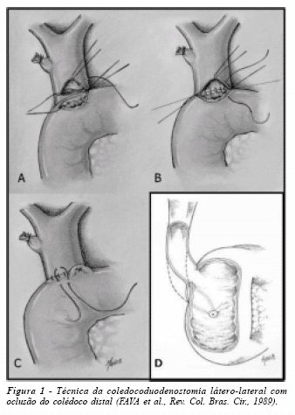
CHOLEDOCHO-DUODENOSTOMY
WELLINGTON 1962 - BR. J. SURG.1966 1961966.

Slide 25
HIS CONTRIBUTION TO SURGERY WAS THE PROMOTION OF CHOLEDOCHO- DOUDENOSTOMY TO RELIEVE BILIARY OBSTRUCTION ASSOCIATED SEPTICAEMIA.
IT WAS PRESENTED AS PAPER IN WELLINGTON IN 1962 AND PUBLISHED IN THE BRITISH JOURNAL OF SURGERY. IT WAS A LIFE SAVING PROCEDURE FOR PATIENTS WITH MULTIPLE COMORBIDITY HIGH ANAESTHETIC RISK.
FIBRE-OPTIC ENDOSCOPIC SURGERY ARRIVED,
AND IT IS NO LONGER USED.

Slide 26
CONCLUSION
THIS PRESENTATION DESCRIBED SURGERY AND GENERAL ATTITUDES 50 YEARS AGO.
RECENTLY THE ATTITUDES TO THE FUZZY WUZZIES WERE LESS POSITIVE, AND POPULAR SURGICAL PROCEDURES ARE CRITICISED WHEN COMPARED TO CURRENT STANDARDS

