Slide 1
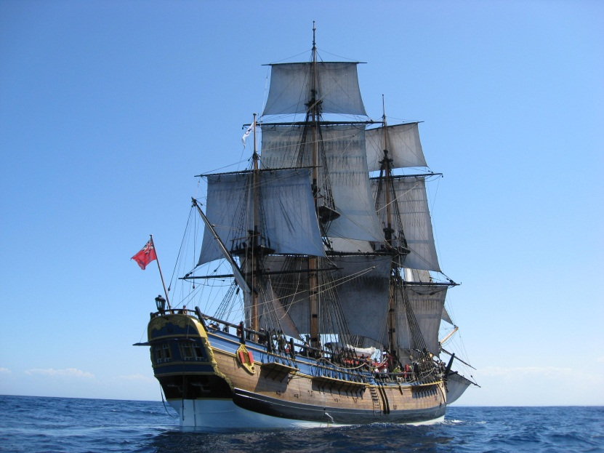
ANMM Presentation
INTRODUCTION

Slide 2
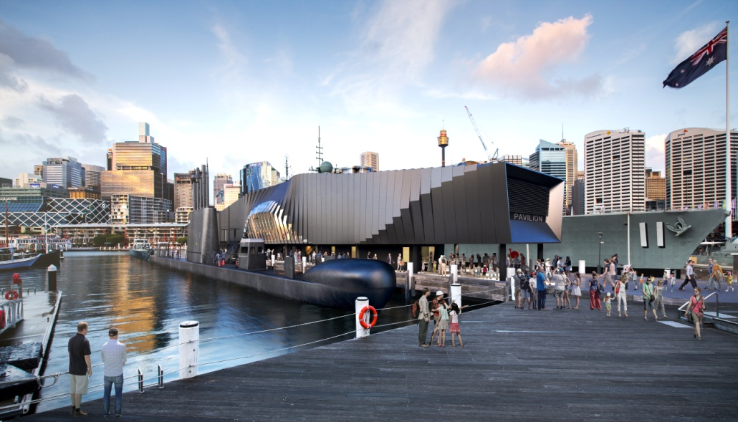
ACTION STATIONS

Slide 3
Damn the Dardenelles!
Notes:
“Damn the Dardenelles, they will be our grave.”
Letter from Admiral Fisher( First Sea Lord) to Winston Churchill (First Lord of the Admiralty) 5th April , 1915

Slide 4
The Navy at Gallipoli
The combined British and French fleet
The Australian Submarine AE2
RAN Bridging Train
Notes:
A combined fleet of British and French warships and submarines were stationed off the Gallipoli Peninsula
The bridging train is a separate topic in itself and won’t be covered here. It consisted of naval personnel doing wharf and landing construction and supplying ammunition, stores and water to the troops

Slide 5
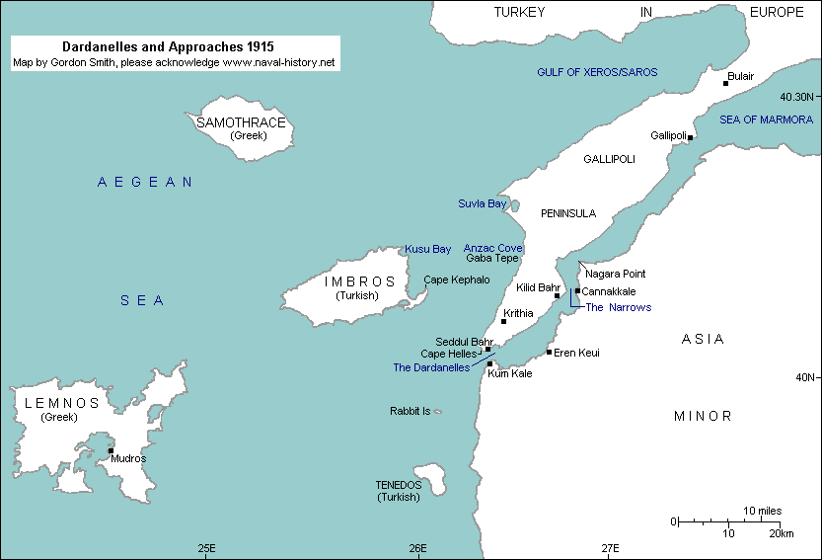
APPROACHES TO THE DARDANELLES
Notes:
The port of MUDROS on Lemnos used as a staging point by the Navy

Slide 6
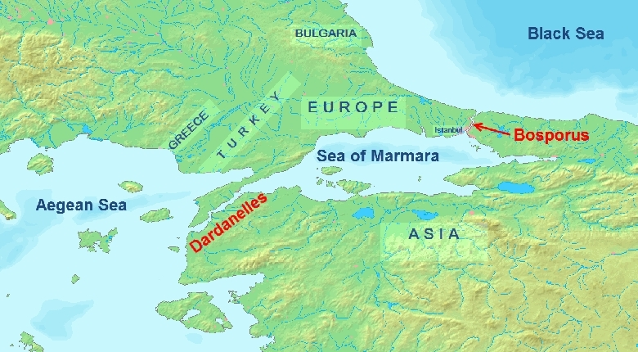
Why are they important?
Churchill wanted to open a new front, capture Constantinople and get Turkey out of the war.
Only way to supply arms and ammunition to Russia is through the Black Sea
Similarly Russia needs to be able to export its grain

Slide 7
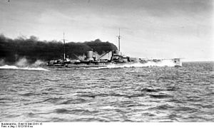
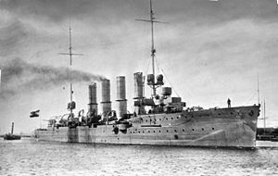
German Ships Escape British Fleet August 1914
SMS’s Goeben and Breslan berth in Constantinople
Notes:
The British fleet had been shadowing these ships in the Mediterranean but lost them and they escaped to Constantinople. Britain was building two battleships for the Turks, but impounded them, so the Germans offered their ships as replacements.
The ships were nominally transferred to the Turks as Battlecruiser “YAWUZ SULTAN SELIM” and light cruiser “MIDILL” still with German crews

Slide 8
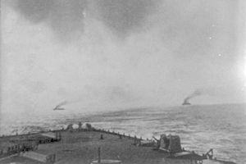
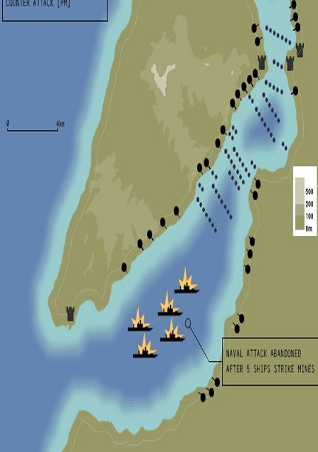
3 Aug 14 Turkey lays minefields in the Dardanelles at 5 metre depth

Slide 9
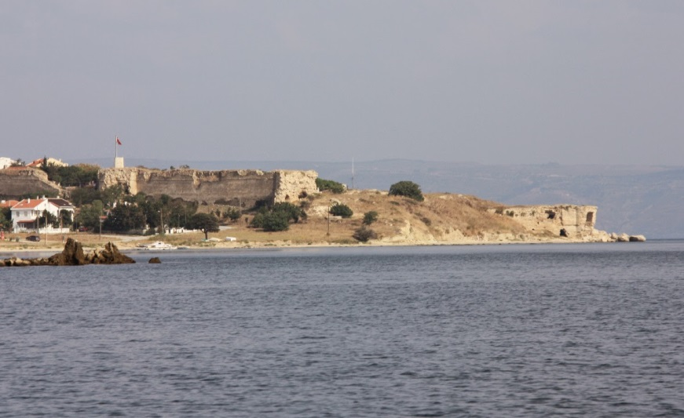
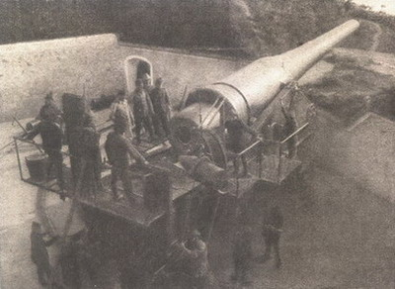
3 November 1914 - Allies bombard outer forts
Alerts Turks to unprepared nature of defences
Ordered by Churchill – test range of defences
Turks recognise possible invasion
Notes:
Actually before Britain’s own declaration of war.
Battlecruisers
Indefatigable
Indomitable
French pre-dreadnoughts
Suffren
Verite’
Limited success but Britain believes warships can defeat shore batteries.
Churchill 1st Lord of Admiralty

Slide 10
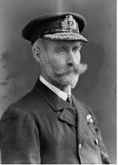
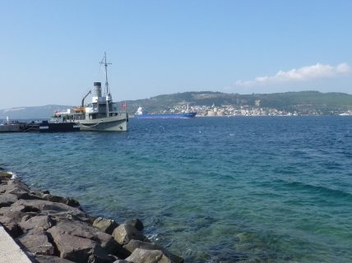
Request to Carden
Churchill asks Admiral Carden for a plan to breach the Dardanelles using ships alone.
Churchill prepared to sacrifice old battleships and crews.
Carden requests 12 battleships, extra submarines and 4 seaplanes and gets them.
Notes:
Apart from the Queen Elizabeth, the other ships at the Dardanelles, although operational, were not considered up
to date enough for the grand fleet. Hence Churchill felt their loss could be accepted.
Carden very reluctant about this approach

Slide 11
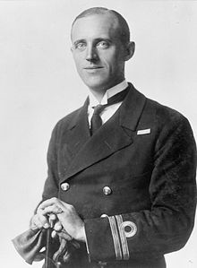
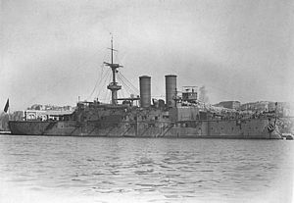
Penetration of minefield by B11
13 DEC 14
Sinks MESSUDIYE
Notes:
Danger was that the s/m could snag a mine mooring line and pull the mine down on itself.

Slide 12
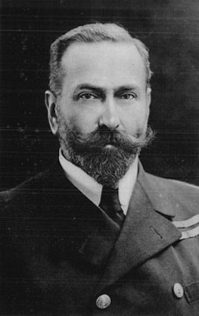
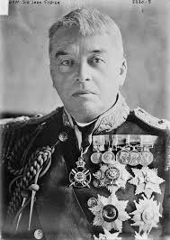
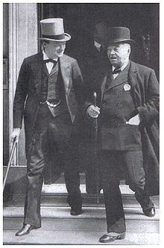
Decision to breach Dardanelles
13 January 1915 – War Council says Navy shall force the Dardanelles.
Admiral Fisher not in agreement
28 January, Admiralty finally agrees – Fisher remained silent and this was taken as his acceptance
Notes:
Churchill’s objective,
Open up another front
Provide access through the Black sea for imports and exports from Russia
Hopefully put Turkey out of the war
Carden believes a month would suffice to knock out the forts up to Kephez Point, destroy the guns around the narrows then clear the minefield.

Slide 13
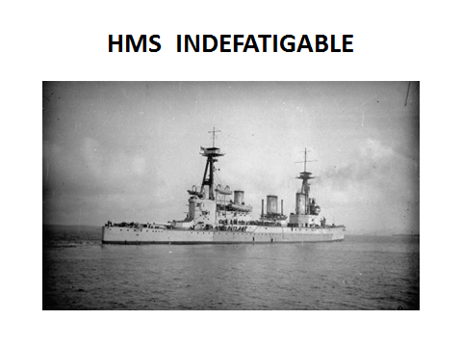
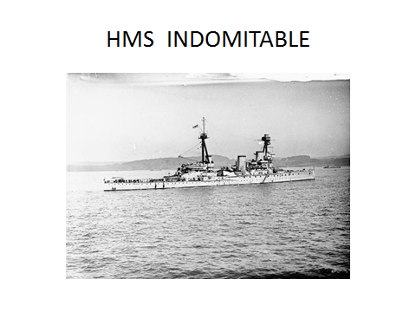
19 February, Fleet bombards outer forts
Naval gunfire has limited effect due to flat trajectory
Called off by bad weather until the 25th
16th March, Admiral Carden taken ill and replaced by Admiral de Roebeck
‘Any sailor who attacks a fort is a fool.’ Nelson
Notes:
12” guns Army howitzers would be more effective
Admiral Carden’s Fleet
Queen Elizabeth – super dreadnought
Inflexible – Battle cruiser
Pre-dreadnoughts
4 French Pre-dreadnoughts

Slide 14
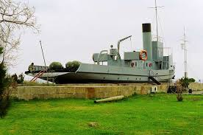
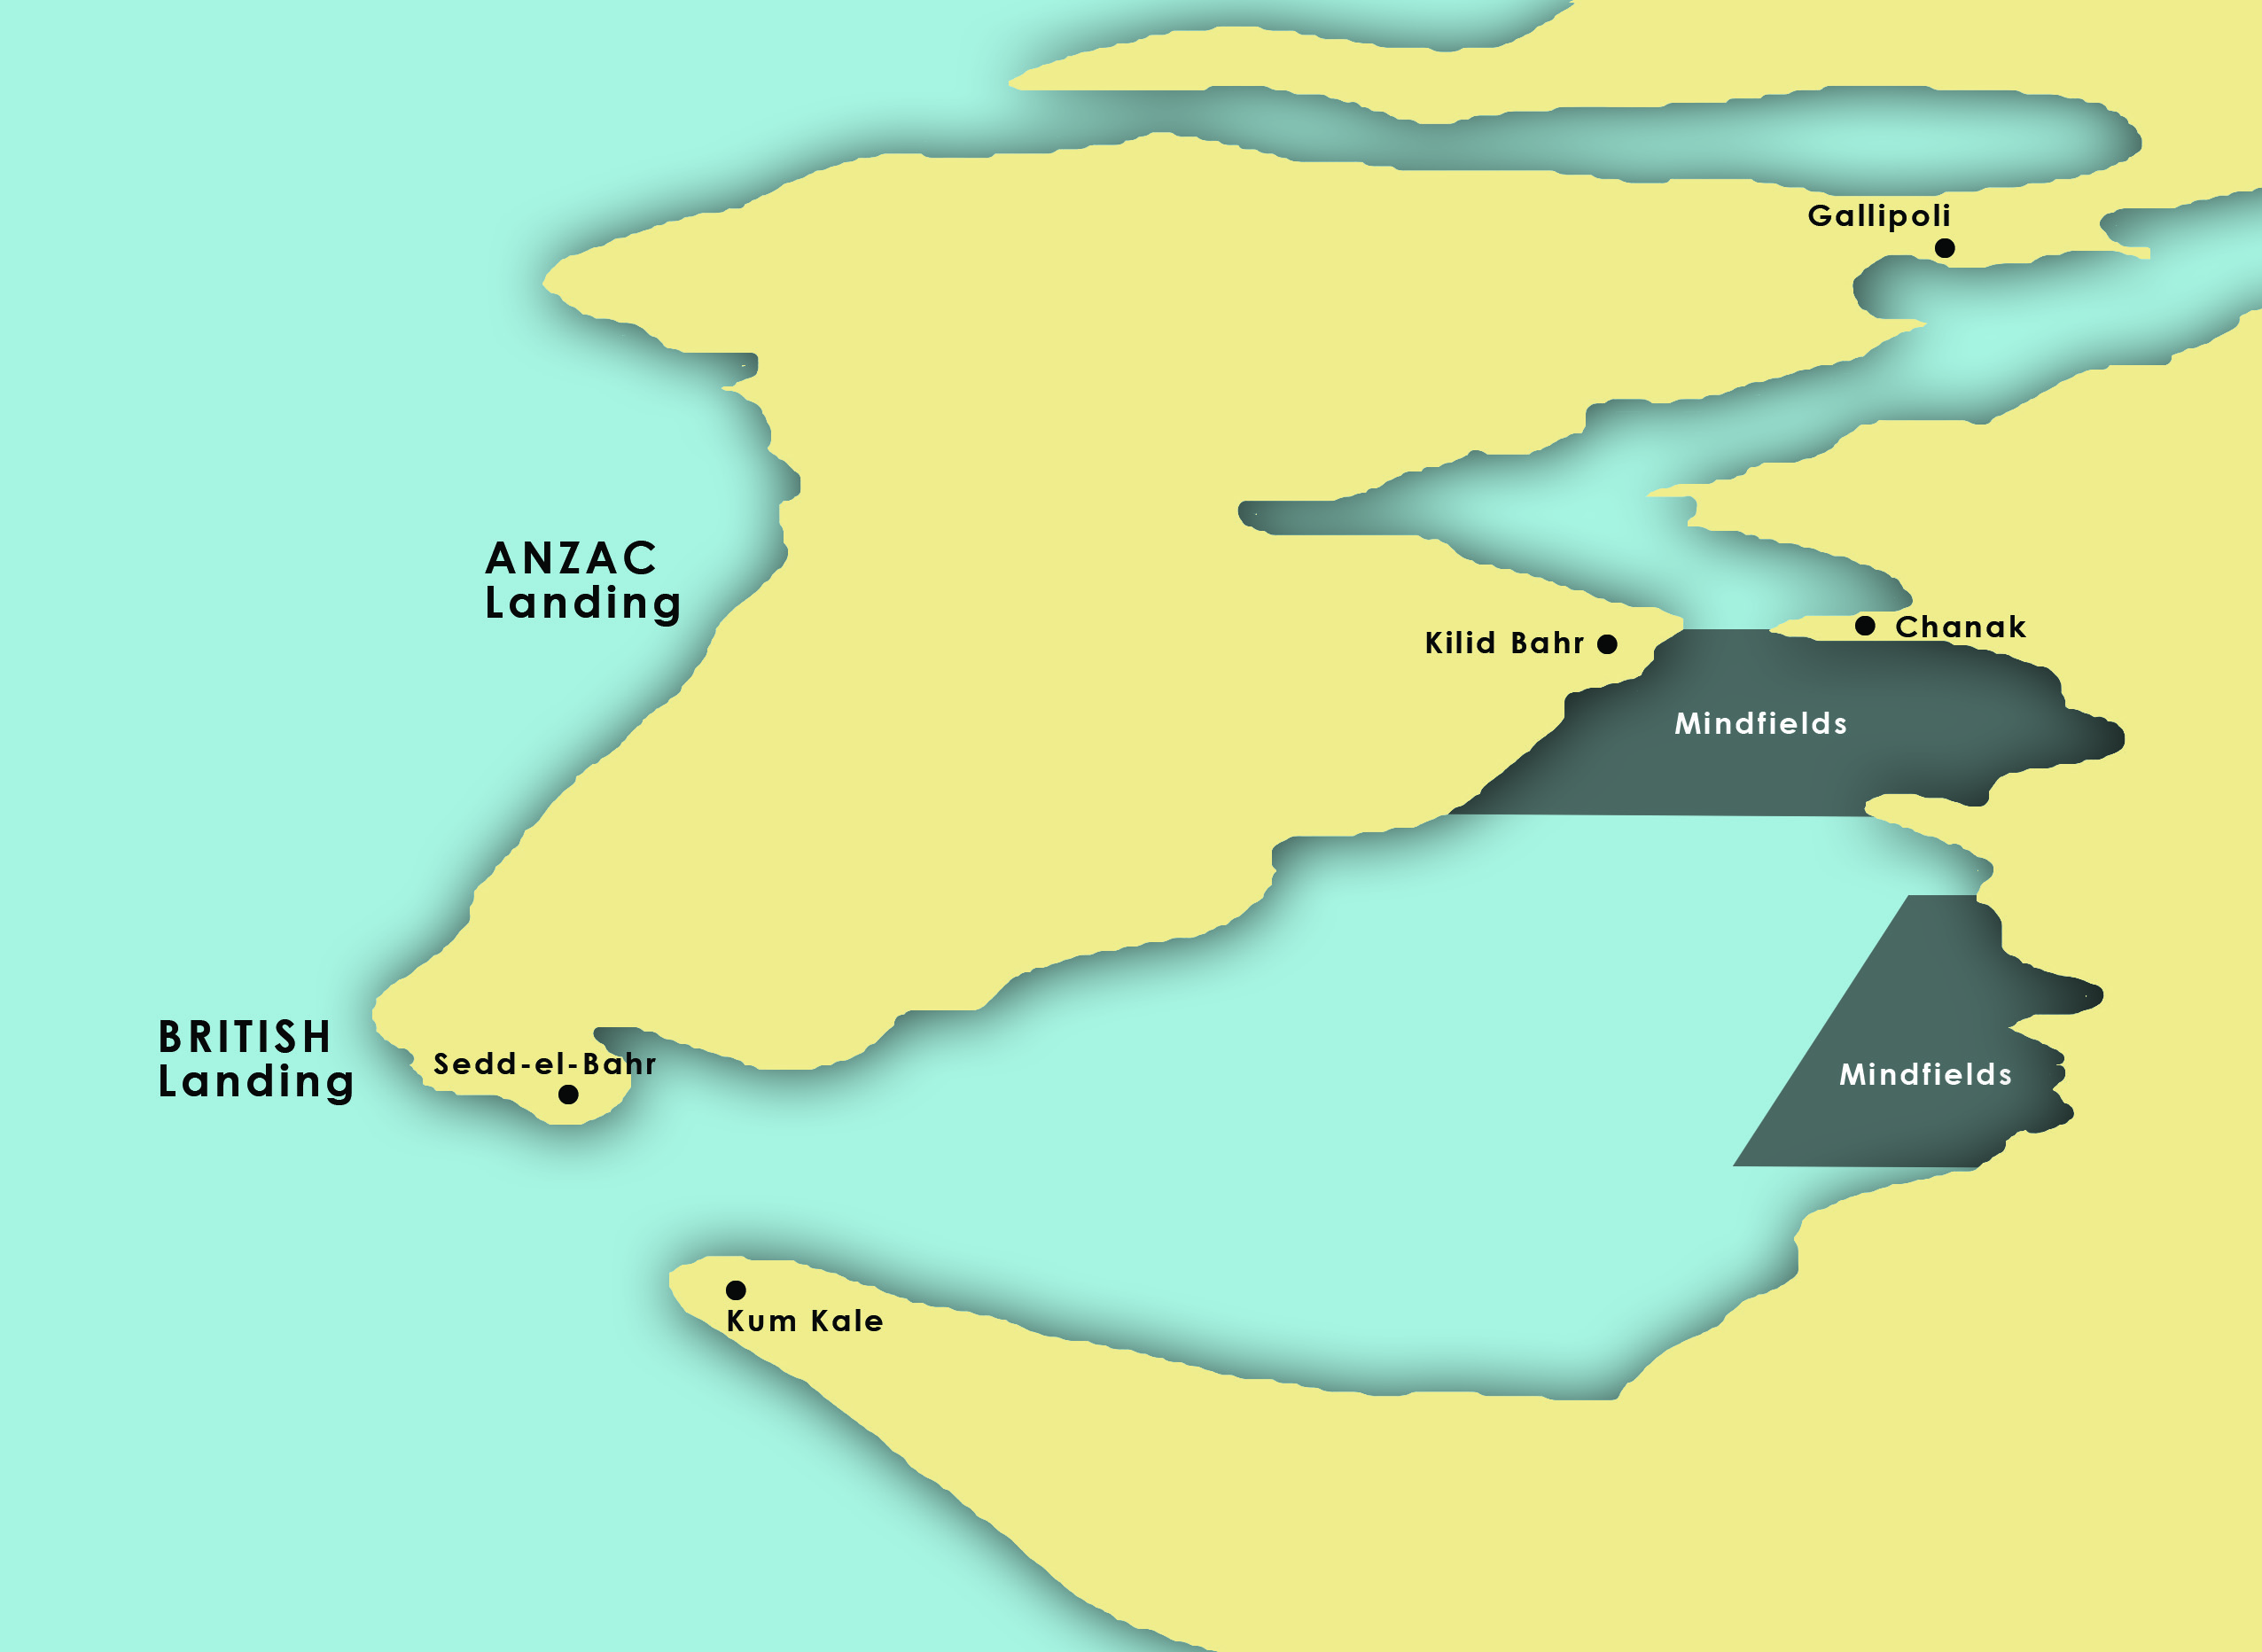
7 March second and offensive minefield laid in the Dardanelles

Slide 15
18 March – Main Naval attack
The ships were bombarding the forts at the Narrows
Three battleships sunk
Three battleships damaged and crippled
Attack aborted
Notes:
Ships were lost or damaged due to the floating mines tethered to the Asiatic shore which both the minesweepers and ships were not aware of.
As a result de Roebuck lost confidence and would not attack again

Slide 16
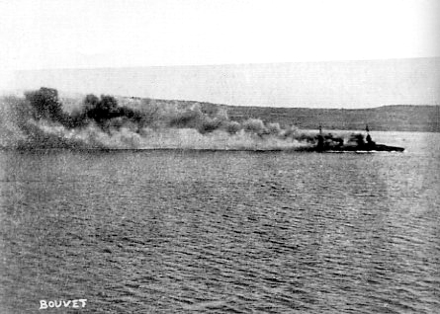
Bouvet sinks in the offensive minefield

Slide 17
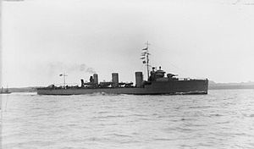
New Minesweepers
BEAGLE class destroyers fitted out as minesweepers and replaced the trawlers
Objective was for the minesweepers to clear the channel then the battle fleet would follow
De Roebeck unwilling to entertain further losses
Notes:
Could operate against the current and had superior sweeps HMS Scrounge at Mudras 1916
Still hampered by searchlights and gunfire

Slide 18
23 March – Breach not possible with ships alone
Admiralty informed success can only be achieved by a joint expedition.
Kitchener to make 75,000 troops available to capture and silence inner forts
Problem – can’t be ready until mid April
Churchill furious at delay
Turks alerted by lack of security and increase defences

Slide 19
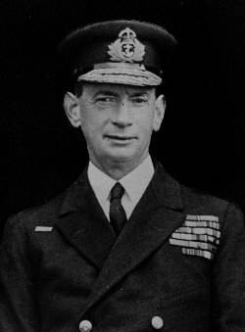
Meeting of S/M C.O.s and CMDR Keyes
Is it possible for a S/M to breach the Dardanelles?
Answer “yes” by all
Attempt on 17 April by E15 . Forced to surface and Captain plus 3 killed. S/M lost
Lieutenant Cdr Stoker, C.O. HMAS AE2, puts forward plan to Commodore Keyes
Keyes gives permission for Stoker attempt
Notes:
Chief od staff to de Roebuck, i.c submarines

Slide 20
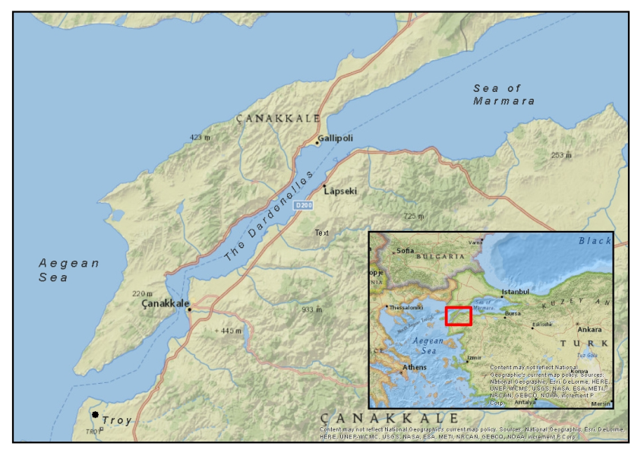
The submarine problem
Canakale to Gallipoli 35 miles
Outflowing current 4 knots
S/M dived speed 5 knots
Therefore speed over ground 1 knot
Battery capacity 5 hours
Surface speed 15 knots
Therefore majority of passage must be made on the surface.

Slide 21
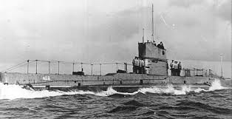
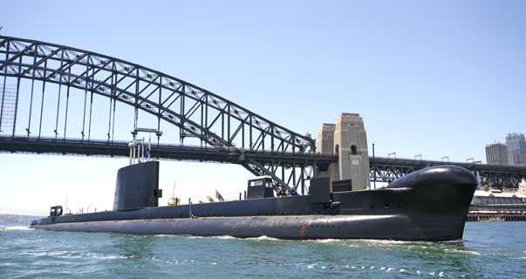
AE2 compared to HMAS Onslow
Length 178 feet
Beam 22 feet
Submerged speed 5 knots
Max. depth 100 feet
Surface speed 15 knots
Crew 32
Armament 8 torpedoes
Displacement 796 tons submerged
295 feet
26 feet
15+ knots
1000 feet
15
68
22 torpedos/SS Missile
2410
Notes:
Some later versions had a gun installed . 3000 horses [10 per sub] Target: 250 horses

Slide 22
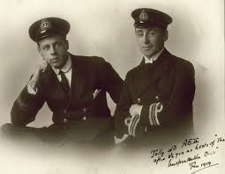
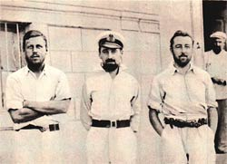
FIRST ATTEMPT – 24 APRIL
Sailed at 0100
Developed hydroplane defect
Returned to base for repairs
Notes:
LEUT Geoffrey Haggard, LCDR Dacre Stoker, LEUT John Carey

Slide 23
Second attempt – 24 April
Sailed at 2230
On surface avoiding searchlights and fire from forts
0100 25 April – dived to maximum depth
0300 Ran aground under a fort – guns could not depress low enough to fire at him
Dived off but ran aground a second time
His presence frightened off a Turkish Monitor that had been shelling the ANZAC landing
Notes:
Stoker discovered that at depth (about 70 feet) there was a counter current flowing inwards at about 4 knots. Hence his surprise to be much further than expected and hence running aground.

Slide 24
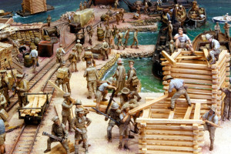
THE ANZAC LANDING
0430 first ANZAC landing against heavy fire
Landing was one mile north of intended beach and extremely difficult terrain
2200 General Birdwood (i/c ANZACs) proposed landing should be aborted and troops withdrawn
Admiral Thursby says it would take two days to evacuate the troops
General Hamilton indecisive

Slide 25
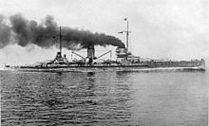
AE2 Progress
Penetrates minefield without incident
Sinks Turkish cruiser
Lies on seabed all day to avoid Turkish ships
2145 surfaced to charge batteries and proceeds into Sea of Marmara.
Signals the fleet that he had successfully penetrated the Dardanelles
What if?
Notes:
Stoker thought his signal had not been received as there was no acknowledgement. He knew that if Keyes knew he had been successful, he would order more s/m to go ahead.

Slide 26
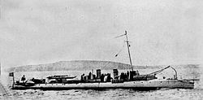
The Sea of Marmara
AE2 spends four days harassing Turkish shipping
Several of the torpedoes were defective
Suddenly loses control and dives below 100 feet
Boat then rapidly surfaces stern first
Turkish gunboat SULTANHISAR fires and hits engine room putting sub out of action
Stoker scuttles boat and crew surrenders
Spends 3 years in P.O.W. camp
Notes:
Loss of control may have been due to mix of fresh and salt water

Slide 27
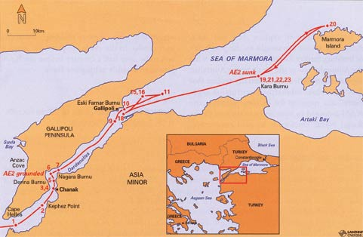

Slide 28
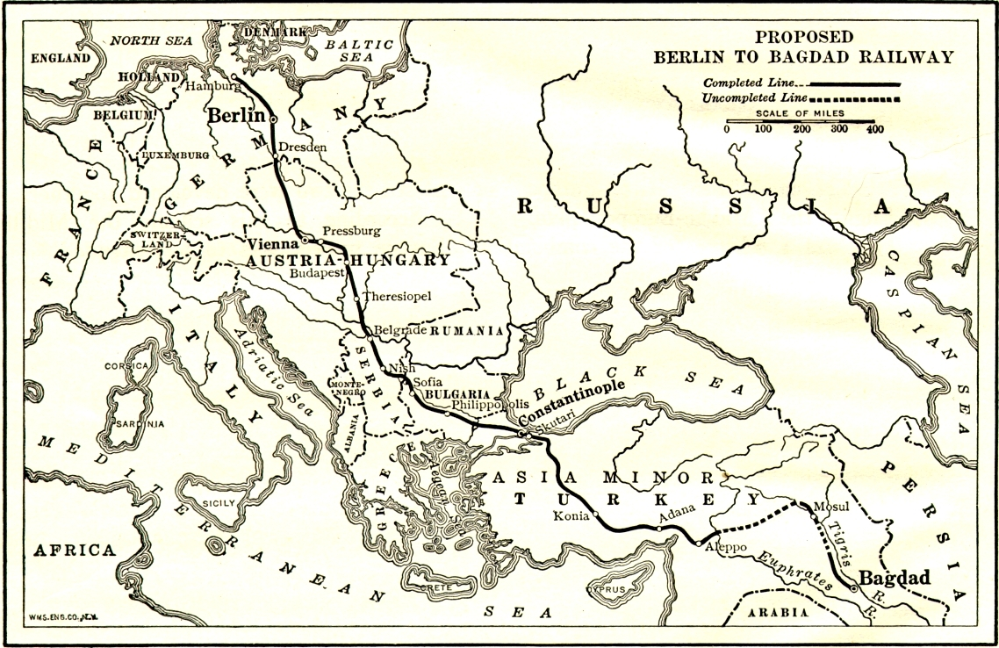
SEAMEN SENT TO WORK ON RAILWAY

Slide 29
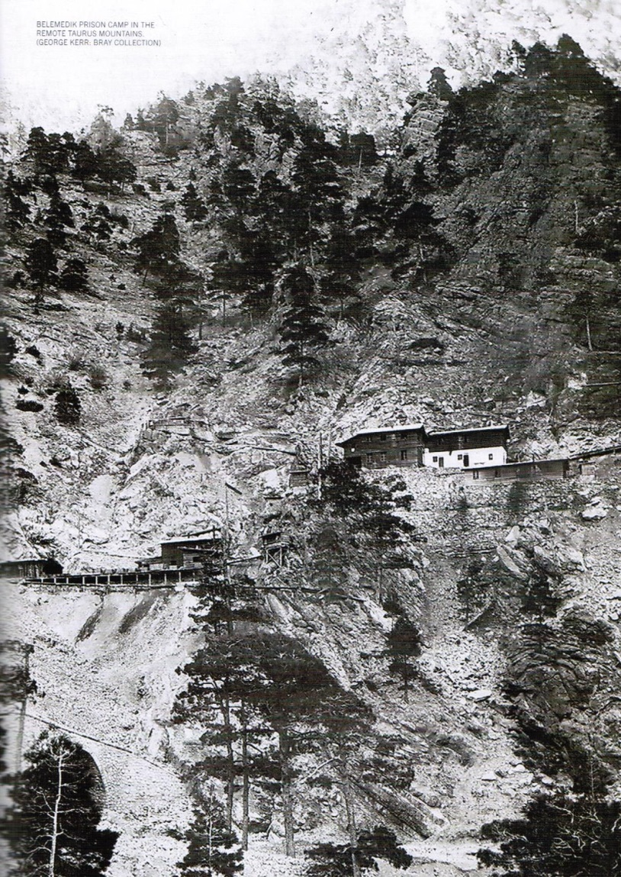
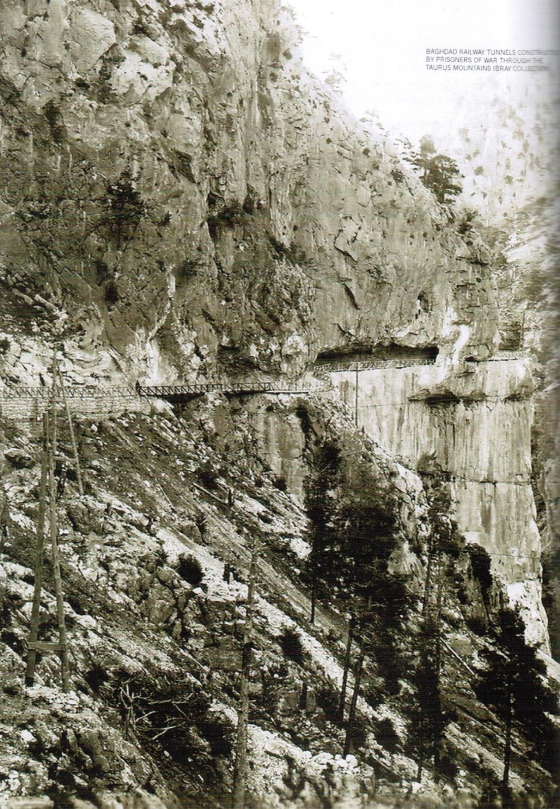
4 Deaths: Malaria , Typhoid, Dysentry

Slide 30
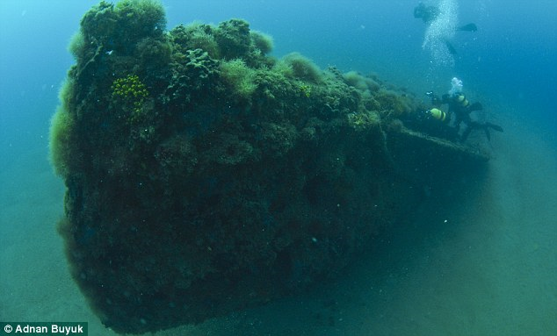
Further Submarines
E14 and E11 followed Stoker into the Sea of Marmara
20 Expeditions
7 Losses
Destroyed 1 Battleship,1 Destroyer,5 Gun Boats,11 Transports, 44 Steamers
* 02 JAN 1916: Mostly over
Notes:
I have counted 12 VCs awarded to naval personnel during the Gallipoli campaign. The one who deserved it most , Stoker, only got a DSO.
E14 wreck discovered at Mouth of Dardanelles

Slide 31
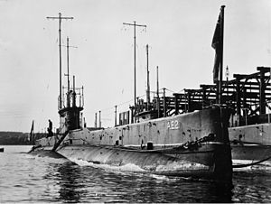
Significance of AE2’s operation
First Allied s/m to penetrate the Dardanelles
Denied the Turks ability to resupply by sea
Ottoman reinforcements and supplies had to reach Gallipoli over poor roads and took much longer
Effect was to ease the pressure on ANZAC and allied troops.
Notes:
Stoker and his crew were released after the armistice in 1918. Later when he was told that his signal had resulted in the continuation of the ANZAC landing, he wished he had never sent it.
November 1915. Kitchener visits Gallipoli. Allied casualties 250,000 including 50,000 killed.

Slide 32
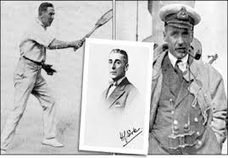
Post War
Stoker DSO, commences a very successful stage career
Leut Haggard DSC, comes to Australia and marries Marjorie Syme
Leut Cary mentioned in despatches
Three of the crew awarded DSMs
Notes:
Stoker: DSO, Haggard DSC, Cary MID, 3 crew awarded DSMs. Re-enlists at start of WW2 CO HMS Minos, Lowestoft Builds minesweepers

Slide 33
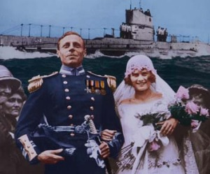

Slide 34
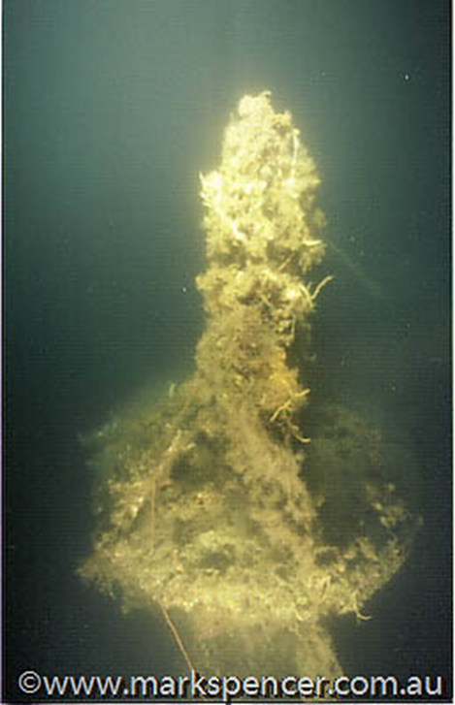
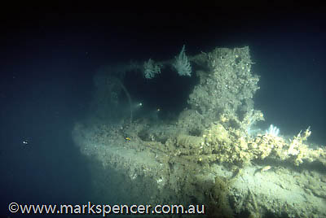
Search for the wreck of AE2
1990 Preliminary search by HMAS SYDNEY
Request to Turkish Navy to assist
September 1998 confirmed by Aust. Dive team as AE2
72 m depth – fully intact
Asset of ANMM
Notes:
Difficult to dive, mixture helium and oxygen tanks, short periods on dive site

Slide 35
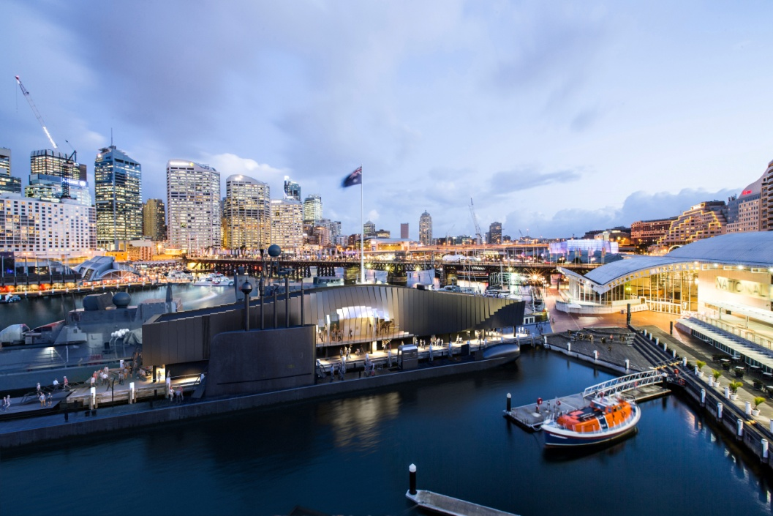
WARSHIP PAVILION

Slide 36
THE MUSEUM
FLEET
GALLERIES
FACILITIES
MEMBERSHIP
VOLUNTEER
PROJECTS
SYDNEY HERITAGE FLEET –
WHARF 7
JAMES CRAIG
WWW.ANMM.GOV.AU
Notes:
ANMM website – www.anmm.gov.au
Homepage
Exhibitions
Events and Activities
Schools
Plan a Visit
Services and Venues
Collections and Research
Join In – Membership, Corporate Membership, Sponsor Us, Volunteer, Donate to the museum
About us

Slide 37
SPECIAL OFFERS
DISCOUNTS
Individual Membership One Year less 20%
($60 – regular $75)
Concession Membership One Year less 20%
($48 – regular $60)
Family Membership One Year less 20%
($104 – regular $130)
Dual Concession Membership One Year less 20%
($72 – regular $90)
Group Bookings entry to museum less 20% Per Visit
Notes:
ANMM website – www.anmm.gov.au
Homepage
Exhibitions
Events and Activities
Schools
Plan a Visit
Services and Venues
Collections and Research
Join In – Membership, Corporate Membership, Sponsor Us, Volunteer, Donate to the museum
About us

Slide 38
THANK YOU
QUESTIONS
DISCUSSION

